Slide 1
Excel Southampton Internship Programme Create a brighter future
Victoria Katon
Internships@soton.ac.uk
http://www.southampton.ac.uk/careers/internships

Slide 2
Excel Southampton Internship Program
2009/10 – 5 internships
2010/11 – 120 internships
2011/12– 168 internships
2012/13 – 171 internships
2013/14 – 212 internships
2014/15 – 430 internships

Slide 3
How does Excel work?
Bespoke Project/ Business need
Local and national SME’s and third sector organisations
Dedicated Internship team
On campus internships across all faculties and departments
Easter, Summer and Term time (4-12 weeks)

Slide 4
Benefits for students
Gain valuable paid work experience
Diverse range of industry sectors with a variety of organisations
All Internships exclusive to UoS students
Support from the Career and Employability Service for application & interview and during internship
Provided with Induction Day and Reflection Workshops
Relate your experiences and skills to the workplace – theory into practice
Notes:
less competition
Students gain transferable skills, personal qualities, confidence and competencies to enhance future career prospects
£7.43
Reflection – understand & identify skills they have developed and how to use them to enhance CV

Slide 5
Application Process
Choose which internship/s you wish to apply to
Submit online application and CV
Internship team screen applications
Successful applications forwarded to the employer
The employer shortlists and interviews (may include assessment)
Successful applicant appointed
Invited to Induction Day

Slide 6
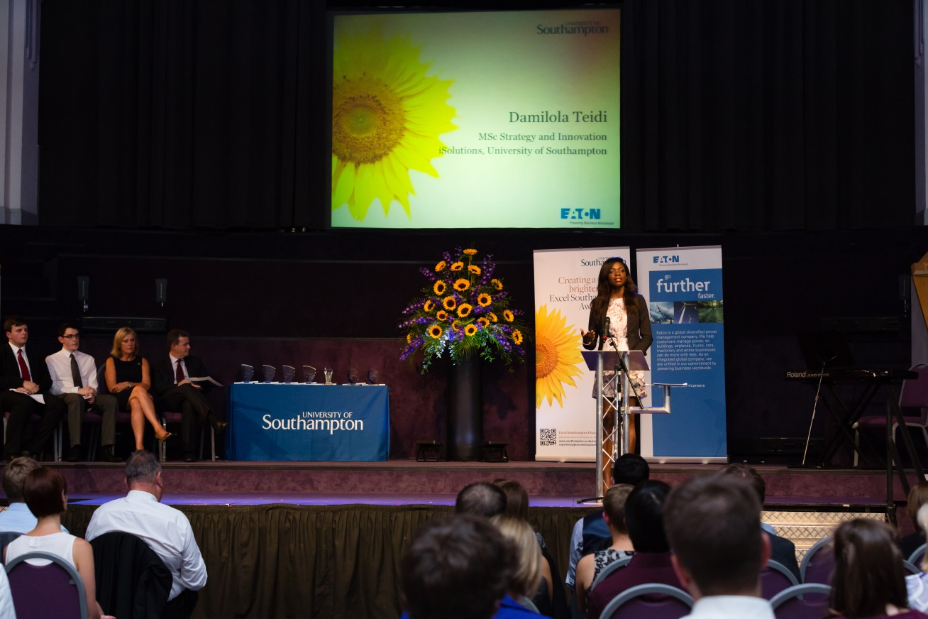
Excel Awards

Slide 7
WSA students on Excel Internships
This year we had 12 students from WSA completing internships
Jaspreet Rana, studying Graphic Arts, on internship with A2 Dominion: “I have learnt that theoretical knowledge, although helpful, is only part of the real experience; being immersed in the practical side makes you learn for yourself.”
Alice Hamilton studying Fashion Marketing, on internship with Oxfam: “It has been interesting to apply the theoretical marketing knowledge that I have gained during my degree so far to a live project… I may even base my final major assignment on the project that I have completed with Oxfam.”

Slide 8
Excel Southampton Internship Programme Create a brighter future
Victoria Katon
Internships@soton.ac.uk
http://www.southampton.ac.uk/careers/internships

