Slide 1
UOSM2008
Self-assessment methods

Slide 2
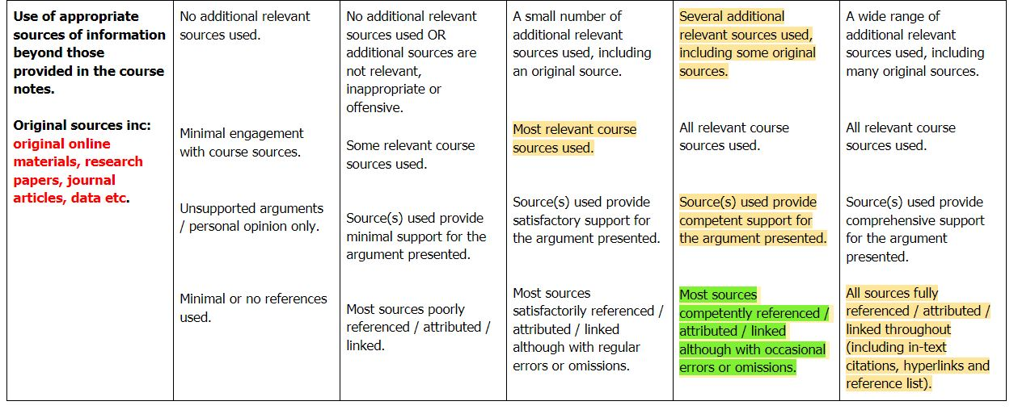
Example 1 – topic 1 post

Slide 3
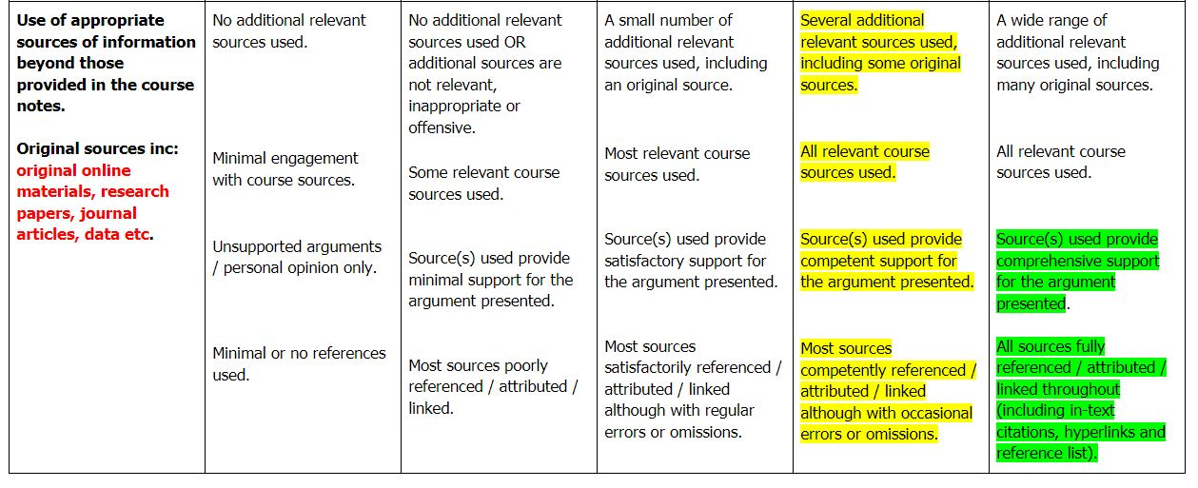
Example 2 – Topic 1 post

Slide 4
Example 1 – topic 1 comments & reflection

Slide 5
Good reflection writing
Portsmouth University ‘ Basic Intro to Reflective Writing’ (v. good resource)
University of South Australia ‘Study Help: Reflective Writing’ short youtube video
Exeter University ‘Reflective Writing Guidance’
University of New South Wales

Slide 6
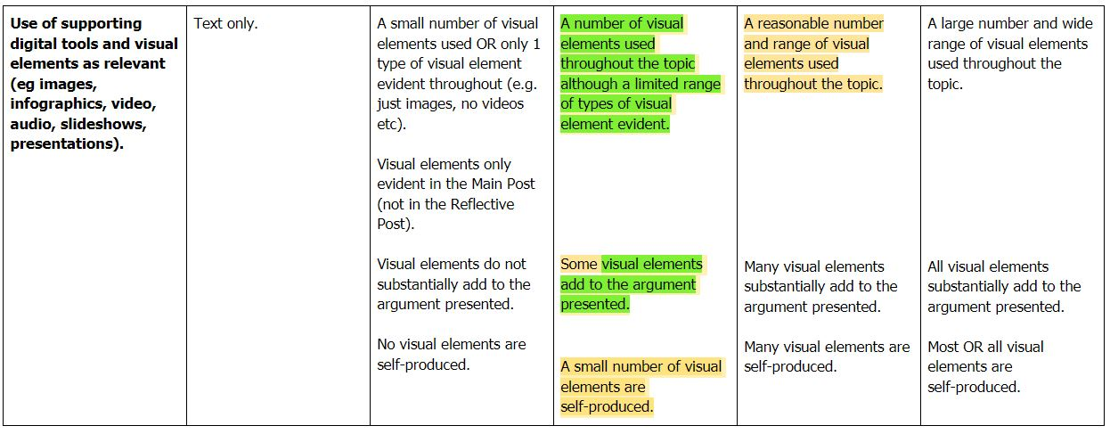
Example 1 – topic 1 overall

Slide 7
Example 2 – topic 1 comments & reflection

Slide 8
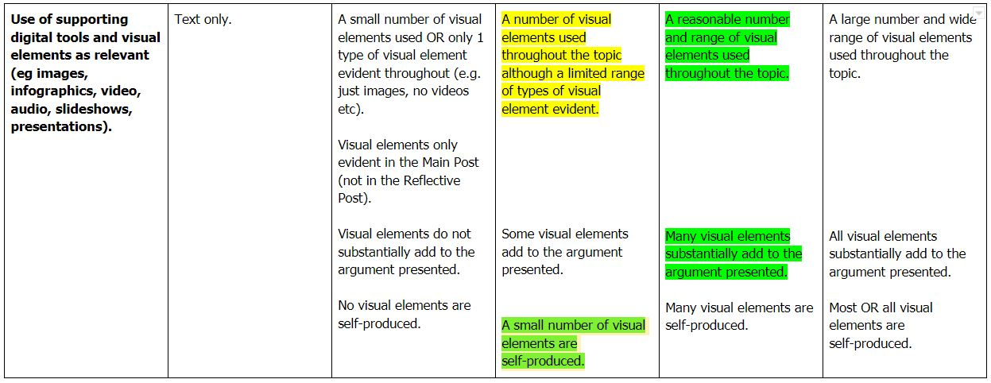
Example 2 – topic 1 overall

Slide 9
Mooc starts on Monday…
Notes:
Be respectful
Open to the world so be careful
Be involved – give before you get…
You’ll be able to post links to your draft video in Step 2.7 of the MOOC for comments from classmates and other participants

