Slide 1
Riddell Chris (2011) Mr Underbed, reprint edition, Andersen press

Slide 2
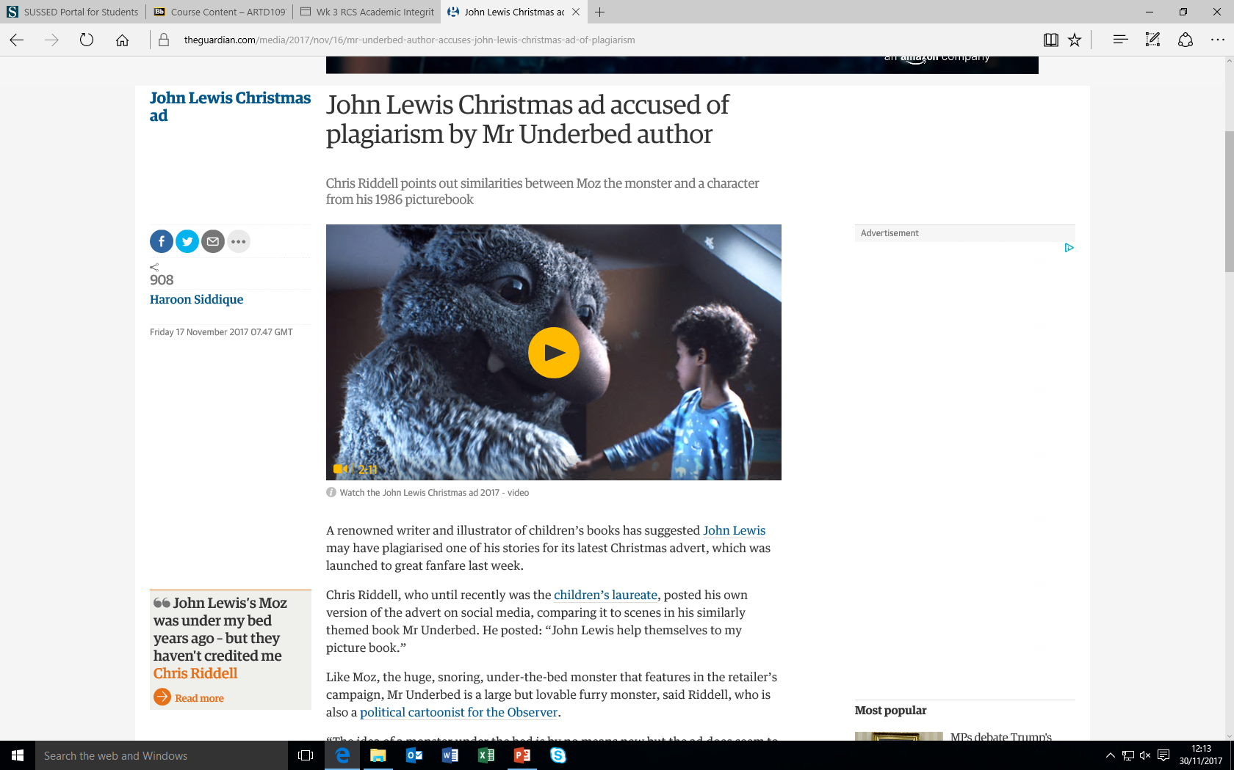
Siddique Haroon (2017) John Lewis ad accused of plagiarism buy Mr Underbed author, The Guardian,17 November

Slide 3
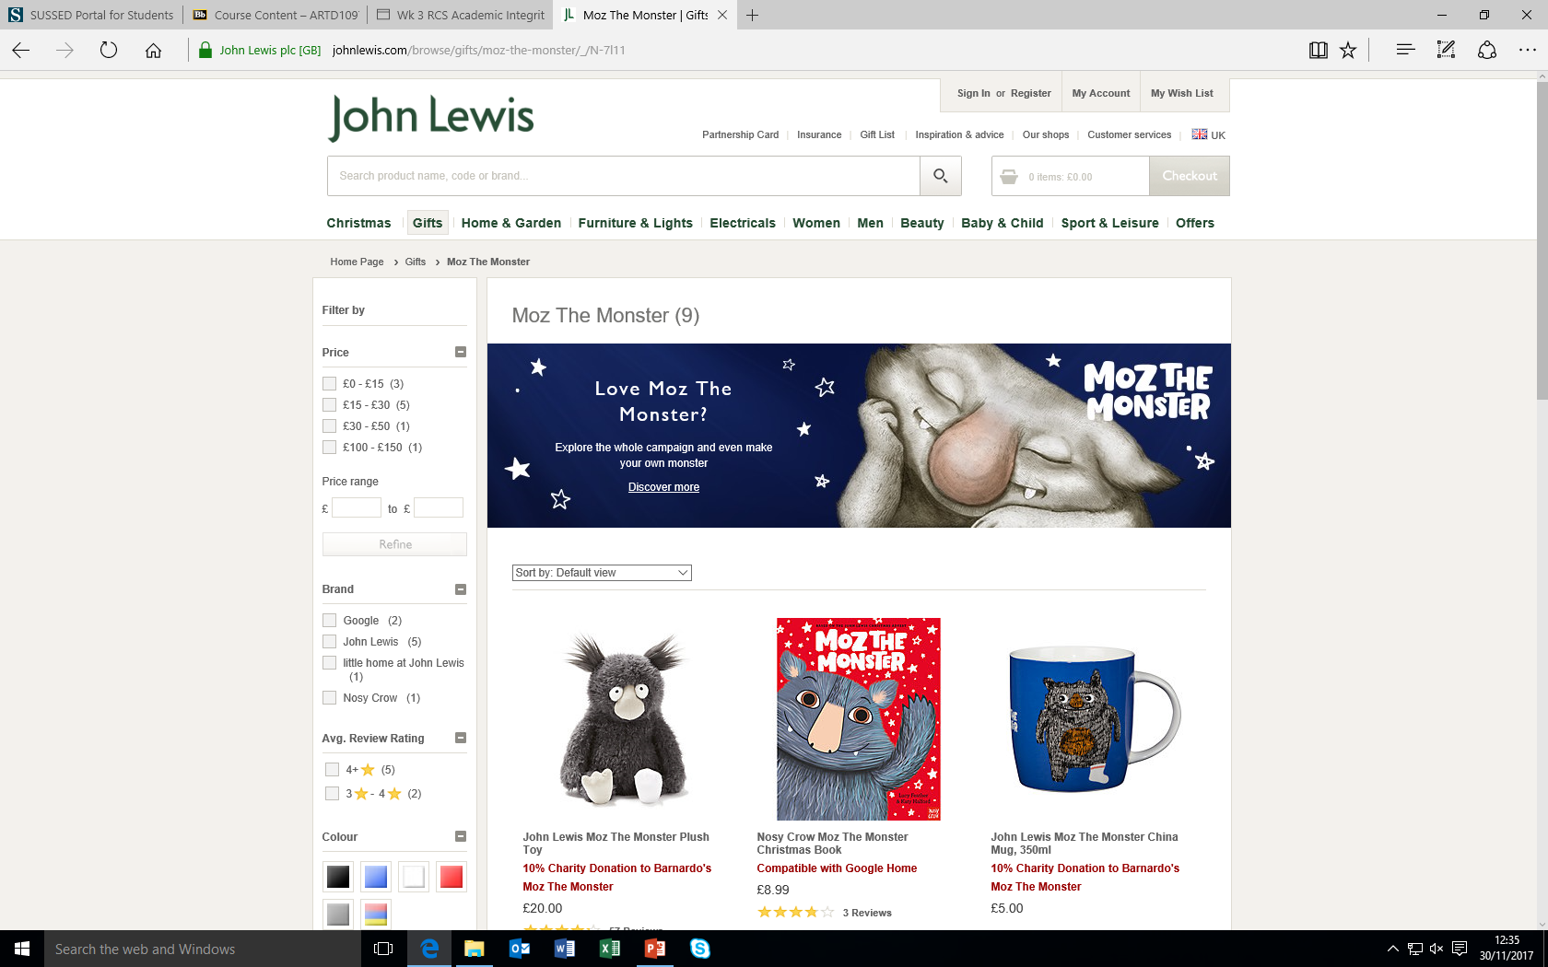
John Lewis partnership (2017) Available from: https://www.johnlewis.com/browse/gifts/moz-the-monster/_/N-7l11 accessed (17th November 2017)

