Slide 1
Coffin Sarah, (2017)The Jazz Age American style in the 1920s
Image of a 1920’s dress. Metallic evening dress, c.1925. Probably American. Silk, woven gold pattern, silk floss embroidery,
gold and silver beads.
Photographer: Sara Hume

Slide 2
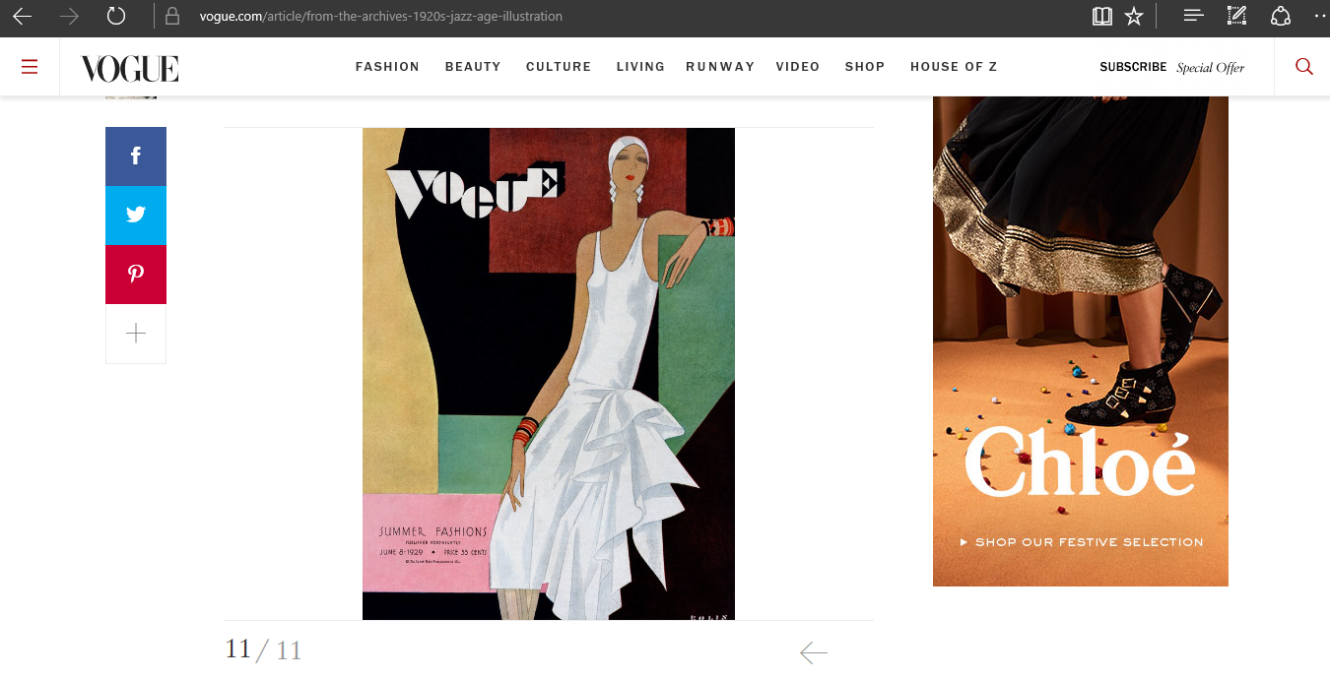
Cover of vogue illustrated by William Bolin, vogue, June 8,1929
https://www.vogue.com/article/from-the-archives-1920s-jazz-age-illustration

Slide 3
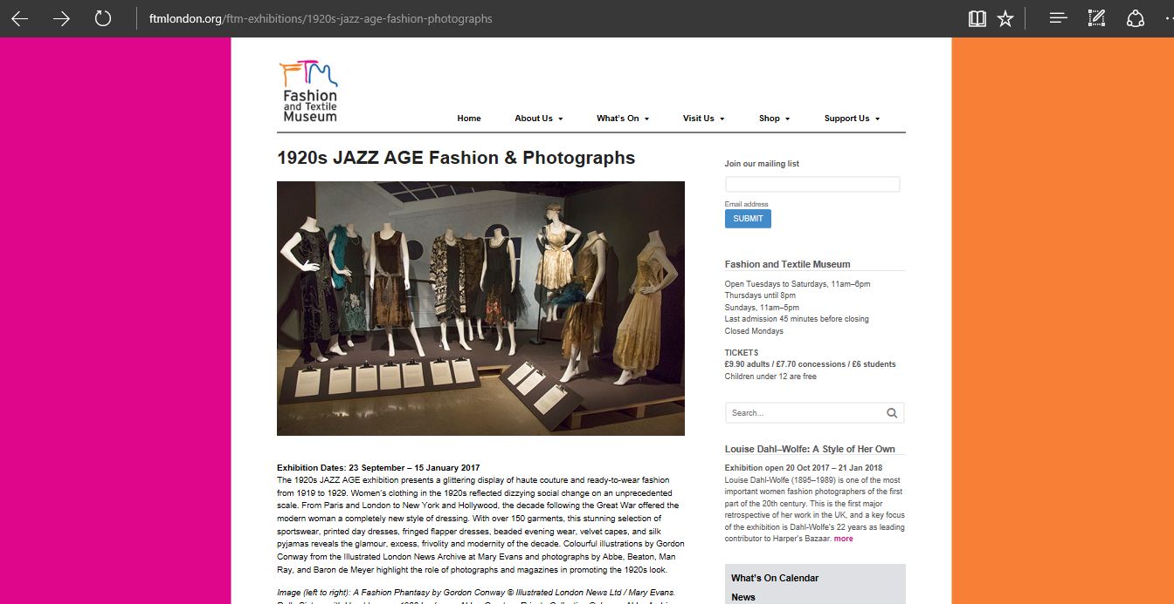
Fashion and Textile Museum available from http://www.ftmlondon.org/ftm-exhibitions/1920s-jazz-age-fashion-photographs/

