Slide 1
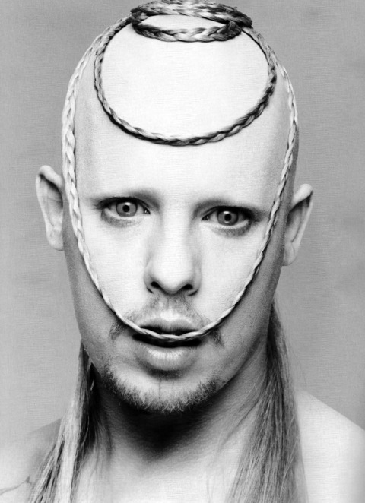
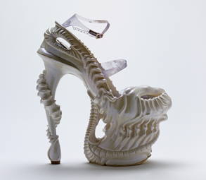
http://www.vam.ac.uk/museumofsavagebeauty/rel/encyclopedia-of-collections-platos-atlantis/
http://savagebeauty.alexandermcqueen.com/platos-atlantis.html
http://www.vam.ac.uk/museumofsavagebeauty/mcq/alien-shoe/

Slide 2
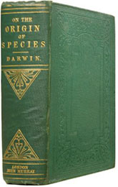
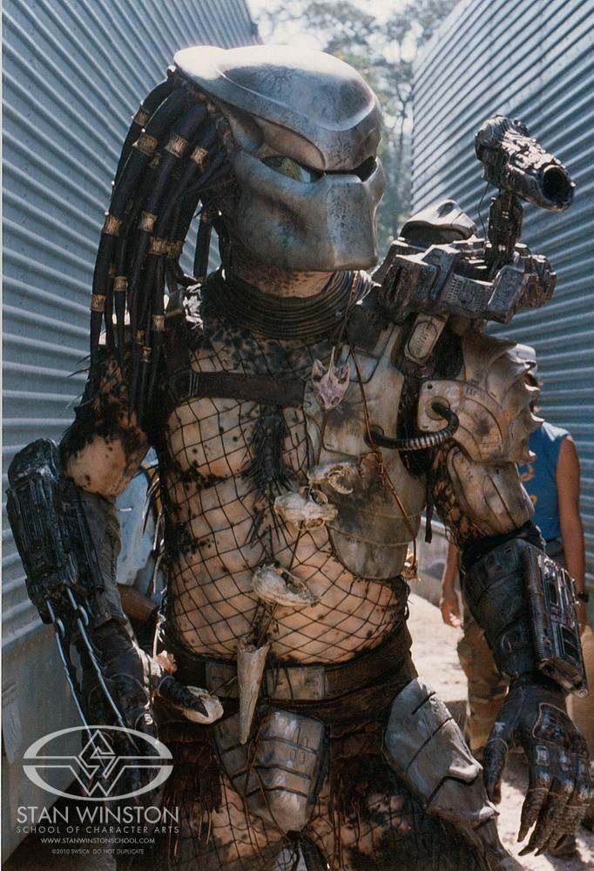
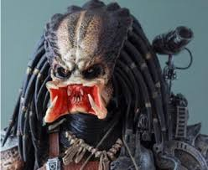
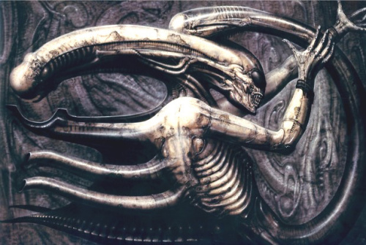
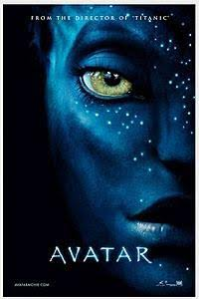
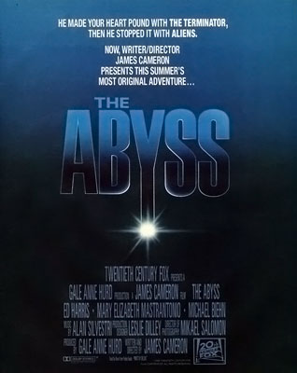
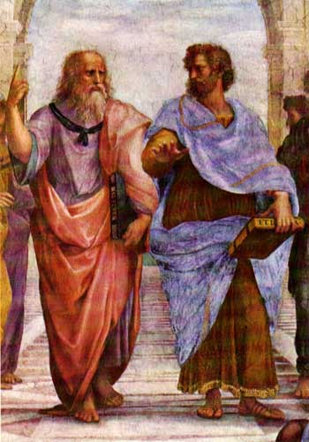

Slide 3
http://www.vam.ac.uk/museumofsavagebeauty/rel/encyclopedia-of-collections-platos-atlantis/
https://www.stanwinstonschool.com/blog/predator-movie-making-the-predator

