Slide 1
Exploring possibilities of teaching English as a Lingua Franca: Participatory action research with South Korean teachers
Koun Choi (1st year PhD student)
University of Cambridge

Slide 2
Problems of current ELT in South Korea
1. Communicative aspect
Exposing learners to only General American accented English
Teaching English as a set of linguistic norms
2. Socio-political aspect
Reproducing dominant ideology
(e.g, Native-speakerism, Standard English ideology)
Teaching how to discriminate non-native varieties and speakers and marginalising one’s own variety of English
English language teaching
Changing English

Slide 3
Theoretical traditions discussing the impact of globalisation on English language teaching
1. English as a Lingua Franca (ELF)
: linguistic features of ELF communication
2. World Englishes (WE)
: diverse NNS English varieties
3. Critical Applied Linguistics (CAL)
: power and ideological issues related to ELT
“ELF Teaching approach”

Slide 4
Examples of the ELF teaching approach
1. Communicative aspect
Raising familiarity and tolerance of diverse varieties (WE, ELF)
Focusing on communication strategies rather than NS-based norms (ELF)
2. Socio-political aspect
Raising critical awareness of hegemonic ideology (CAL)
Empowering students as legitimate users of English (ELF,CAL)

Slide 5
Teacher cognition research about ELF teaching approach
Jenkins (2005): negative attitudes towards NNS’ accents and unwillingness to adopt the ELF approach in pronunciation teaching
Sifakis & Sougari (2005): strong belief in the legitimacy of NS norm bound pronunciation teaching
Young & Walsh (2010): strong belief in standard English as the most pragmatic variety in their local contexts
Dewey (2012): interests in concepts of ELF but sceptical towards practical application of the ELF teaching approach

Slide 6
Why ELF-informed Teacher Education?
Compared to descriptive teacher cognition research, there are only a few intervention studies looking at change in teachers’ beliefs (e.g., Hall et al, 2013; Sifakis & Bayyuart, 2015).
So far, no research explored the process of in-service teacher change through ELF-informed teacher education. Previous research focused on reporting the result of ELF-informed teacher education. Although these studies generated a tentative answer to the question whether ELF-informed teacher education impacts teacher cognition, we still do not know how and under what circumstances a teacher develops critical language awareness through ELF-informed teacher education.

Slide 7
Complexity theory as a framework for teacher change
Complexity theory “aims to account for how the interacting parts of a complex system (teacher cognition) give rises to the system's collective behaviour and how such a system simultaneously interacts with its environment” (Larsen-Freeman & Cameron, 2008, p.1, bracket inserted by me).
teacher learning is a complex process which is shaped through interaction with the experience an individual teacher has, rather than a product of a TD course. Taking the non-reductionist approach to teacher learning, complexity theory aims to elucidate multiple causal factors of teacher change, as well as idiosyncratic patterns of individual development.

Slide 8
Participatory action research as a tool of teacher development
Action Research: a self-reflective form of inquiry by practitioners to understand their practices and the situations which these practices are carried out, and to improve the rationality and justice of their practice (Carr & Kemmis, 1986).
Participatory Action Research: a collective form of action research among researcher and practitioners
Theoretical learning is not enough to lead to informed action. Participatory action research could narrow the gap between theoretical knowing and practical knowing and help teachers develop praxis.

Slide 9
Research Questions
R.Q. 1 What are the developmental patterns of teachers’ belief systems during ELF-informed teacher development programme?
R.Q. 2: How does teachers’ critical reflection on their beliefs through the lens of expert knowledge, if at all, influence the development of critical language awareness?
R.Q. 3: How does participatory action research involving planning, implementing, observing and reflecting on ELF-informed lessons, if at all, influence the development of critical language awareness?
R.Q. 4: Are there individual differences in developmental patterns of belief systems? Then, how does complexity theory lend explanation to factors contributing to such individual differences?

Slide 10
Research Methodology
Case Study
8 South Korean primary school EFL teachers enrolled in a Master’s programme in a Korean university (They are practicing teachers in state schools and will have come to university to take lectures only during their school vacation.)

Slide 11
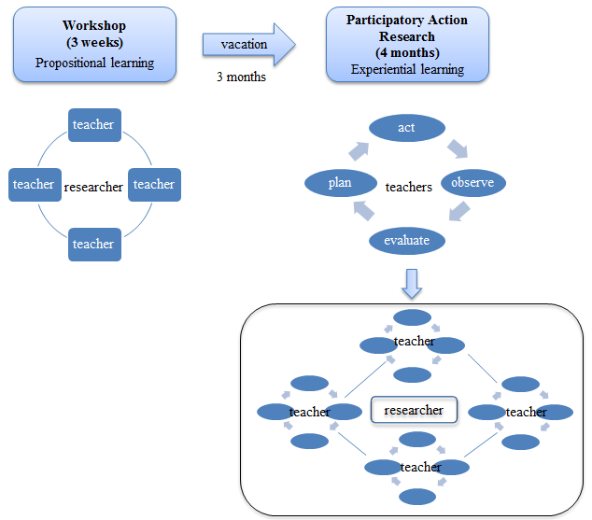
ELF-Informed TD Programme

Slide 12
Phase 1: Workshops (3 weeks)
Critical reflection model
(Brookfield, 1995)
Plans for workshop sessions
1. Assumption Analysis
2. Contextual awareness
3. Imaginative speculation
4. Reflective scepticism
1st session: Critical reflection
2nd-4th session
ELF-informed Session
5th session: Action research planning

Slide 13
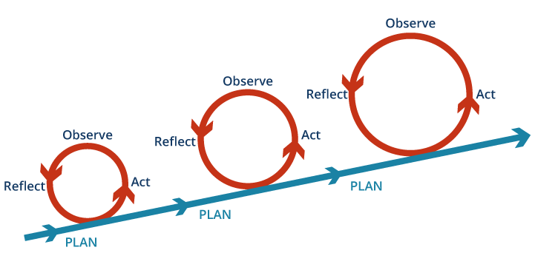
Phase 2: Participatory Action Research (4 months)
Action research cycle adapted from
Crane & Richardson (2000)

Slide 14
Data Collection
Research methods
- Semi-structure interview
- Reflective writing
Plans for data collection
 |  | Workshop |  |  |  |  |  | Action research
Session/Cycle |  | 1st | 2nd | 3rd | 4th | 5th |  | 1st | 2nd | 3rd | 4th
Interview | Pre- |  |  |  |  |  | Post-
Reflective writing

Slide 15
Data Analysis
R.Q. 1 What are the developmental patterns of teachers’ belief systems during the ELF-informed TD programme?
Multiple-case analysis of the developmental process of an individual teacher’s belief system
To establish the patterns of the development, I will identify snapshots of a teacher’s belief system at different stages of the intervention and compare them to each other.

Slide 16
Data Analysis
R.Q. 2: How does teachers’ critical reflection on their beliefs through the lens of expert knowledge, if at all, influence on the development of critical language awareness?
In-sessional reflective log
- describe usual teaching practice or a critical incident related to today’s topic
- scrutinise any rationale of teaching in this way
- imagine alternative solutions
- critically examine the validity of current belief and practice
Interview
- What do you think about the ELF approach that you learnt?
- Does critical reflection affect your views on English and ELT?

Slide 17
Data Analysis
R.Q. 3: How does participatory action research involving planning, implementing, observing and reflecting on ELF-informed lessons, if at all, influence the development of critical language awareness?
Reflective journal
Interview
- Were there any interesting incidents that you want to share?
- In what way does conducting the action research project influence your perspectives on English and ELT?

Slide 18
Data Analysis
R.Q. 4: Are there individual differences in developmental patterns of belief systems? Then, how does complexity theory lend explanation to factors contributing to such individual differences?
Cross case analysis
Initial condition: analysis of the background interview data and pre-workshop interview data
Interactions with other systems (peer, students, school etc.): analysis of interview data and reflective writing

Slide 19
Preliminary findings from pilot study
Post-workshop session Interview (after 1 hour of workshop)
Problem posing
“ In my school, there are some students who studied English abroad. There is a student who spent 6 months studying English in the Philippines. Other students talk badly about her English because they think she has a Filipino accent, but in fact, she does not have a Filipino accent. But students who studied in Canada or England receive compliments about their accents from their friends. I think students think Canadian and US English is superior than other varieties“
Unexamined assumption
“ I assume if one has a good proficiency based on American or British English, he/she will understand other varieties of English very well, just like a native speaker could understand varieties of English.”

Slide 20
Preliminary findings from pilot study
Post-workshop session interview (after 1 hour of workshop)
Impact of beliefs about learners on teacher’s perspective on the ELF approach
“Incorporating varieties of English in classroom is too difficult in practice
because it is even difficult for students to comprehend the inner circle
English.”
Impact of school assessment on teacher’s perspective on the ELF approach
“For example, if we teach students that ‘fish’ and ‘fishes’ are both intelligible
and correct English, it will cause them to be confused more. It will also cause
problems for assessment because some might argue ‘fish’ is correct and
other will say ‘fishes’ is correct.”

Slide 21
References
Brookfield, S. D. (1995). Becoming a critically reflective teacher. San Francisco: Jossey Bass.
Carr, W., & Kemmis, S. (1986). Becoming critical: education knowledge and action research. London: Routledge.
Dewey, M. (2012). Towards a post-normative approach: Learning the pedagogy of ELF. Journal of English as a Lingua Franca, 1(1), 141–170. doi: 10.1515/jelf-2012-0007.
Hall, J., Wicaksono, R., Liu, S., Qian, Y., & Xiaoqing, X. (2013). English reconceived: Raising teachers’ awareness of English as a ‘plurilithic’ resource through an online course. London: British Council.
Jenkins, J. (2005). Implementing an international approach to English pronunciation: The role of teacher attitudes and identity. TESOL Quarterly, 39(3), 535–543.
Larsen-Freeman, D., & Cameron, L. (2008). Complex systems and applied linguistics. Oxford: Oxford University Press.
Sifakis, N. C., & Bayyurt, Y. (2015). Insights from ELF and WE in teacher training in Greece and Turkey. World Englishes, 34(3), 471–484.
Sifakis, N. C., & Sougari, A.-M. (2005). Pronunciation issues and EIL pedagogy in the periphery: A survey of Greek state school teachers’ beliefs. TESOL Quarterly, 39(3), 467–488.
Young, T. J., & Walsh, S. (2010). Which English? Whose English? An investigation of ‘non-native’ teachers’ beliefs about target varieties. Language, Culture and Curriculum, 23(2), 123–137.

