Slide 1
The Role of English in Internationalisation and Global Citizenship Identity in South Korean Higher Education
Claire Cavanagh
University of Southampton
cc9e12@soton.ac.uk

Slide 2
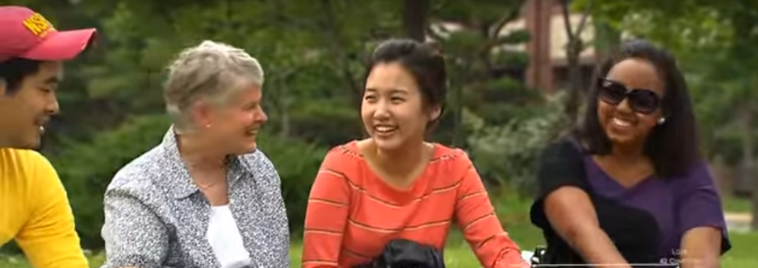
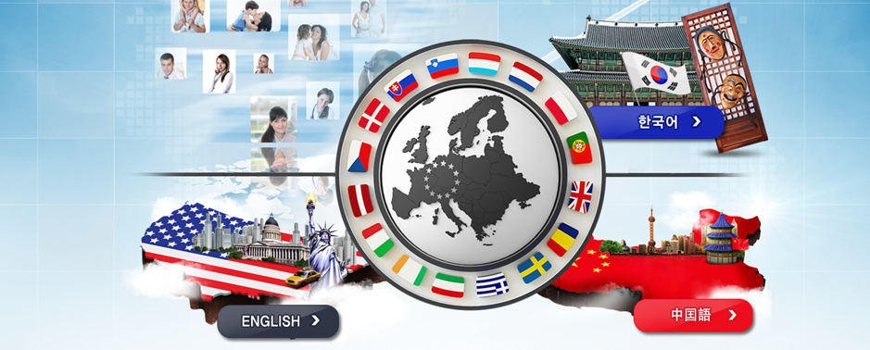
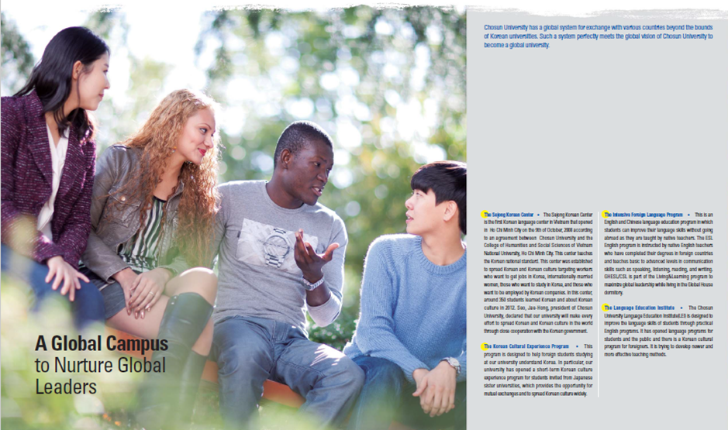
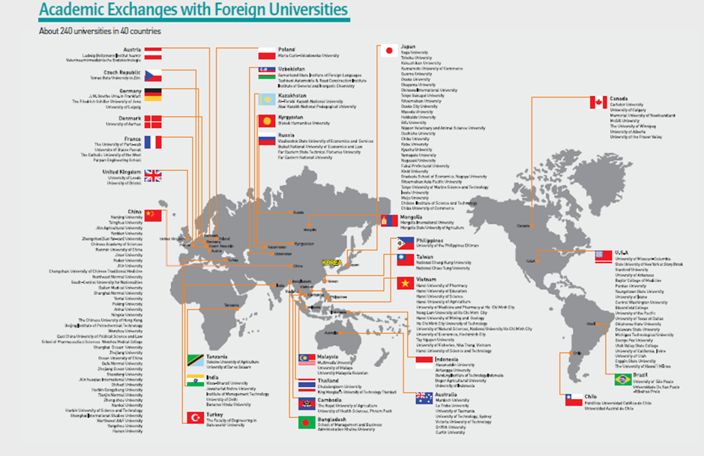
‘Koreans cannot become global citizens without a good understanding of their own culture and tradition…Only when the national identity is maintained and intrinsic national spirit upheld will Koreans be able to successfully globalise’ (President Kim, 1996,p.15)

Slide 3
Research Questions
How do two South Korean Higher Education Institutions (UNI/A & UNI/B) present the role of English with regard to internationalisation on their websites?
How do South Korean students enrolled in these institutions perceive the policies and practices of English with regards to internationalisation?
How do students conceptualise Global Citizenship identity?
What meanings do they attach to Global Citizenship identity?
How do they negotiate and reconcile their Korean identity with Global Citizenship identity?

Slide 4
Internationalisation in South Korea
‘Gullobeol-hwa’ (Globalisation) (Im & Kim, 2015)
Internationalisation = Non-Korean (Palmer & Cho, 2011)
EMI ‘overwhelms’ internationalisation process (Byun et al., 2011)
Arguments of ‘proficiency’ (e.g. Byun et al., 2011; Kim, 2011; Jang & Kim, 2013; Im & Kim, 2015; Kim et al., 2016)
‘Proficiency’ = ‘Native’ English? (Im & Kim, 2015)

Slide 5
Methodology
Methodology
Interpretive Qualitative Approach
Site & Participant Selection
2 Universities: UNI/A, UNI/B (Regional City)
Website Analysis
Discourse Analysis (Fairclough, 2001)
Participants (n=20)
Multimodal Analysis (Pauwels, 2012)
Jan 2014-May 2014
Interviews
Semi-structured & Unstructured Interviews
Analysis: Thematic Analysis (Braun & Clarke, 2006)
Discourse Analysis
RQ3: Identity Theory (e.g McCall & Simmons, 1978; Stryker, 1980; Stets & Burke, 2005; Stets, 2006)
Social Identity Perspective (e.g. Tajfel, 1978; Either & Daux, 1994; Spears, 2012)

Slide 6
Website Analysis & Discussion
‘ [UNI/A], which has a proud historical background and university ideals, has led university innovation movement and today continues its vigorous efforts to meet global standards of the university. Please watch [UNI/A] plan the future based on tradition and history of 61 years as a tree with deep roots does not sway in the wind.’
(UNI/A, Ideals & Objectives)

Slide 7
Website Analysis
‘We nurture global citizens who will be active in global stages with global views’
(UNI/A, English home page)
‘Fostering global leaders with International Perspectives’ (UNI/B, English 2013 Brochure)
HOW?
UNI/A: ‘ESL language program’
UNI/B: Various English Programs

Slide 8
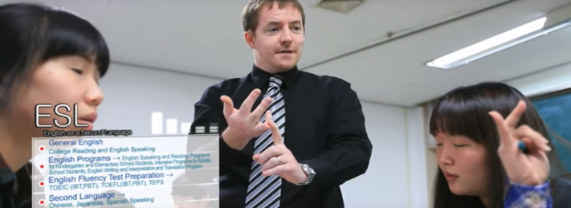
English for Global Communication ‘designed to be in step with ever evolving global society in which we live’
‘…provide students with high-calibre native English teachers’
‘ Some emphasis is also placed on breaking the ‘’Konglish’’ factor in that effort is made to correct the common errors that all beginner Korean-English students make’

Slide 9
Student Perceptions
S10: There are English class(.) and sometime the
professor take(.)deliver the lecture only in
English(.) but you know there’s no native speaker
for economic departments just only for there are (2)
native speaker in another department but I don’t
know why there’s no in economy(.) so usually the
Korean professor do the lecture in English but
there are a LOT of problems because their
pronunciation is very Konglish…they use the(.) I
don’t want to judge them but honestly their
speaking style is very old generation style like
Konglish(?)

Slide 10
Global Citizenship Identity Meanings
English (Native-like)
Multilingual
Morally Concerned
Multiculturally Connected
Open-minded

Slide 11
Global Citizenship Identity & Korean Identity
English viewed as non-Korean (American)
Global Identity Salient
Global & Korean identities symbiotic
Korean Identity Salient
‘Korean English also can be English[…] everything can be English like every style can be English so I don’t need to judge one English like a different English we have different style English and they have also different style so my mind also change so nowadays I like Konglish style English’ (S10)

Slide 12
Conclusions
Internationalisation & Global Citizenship = (American native) English
Ideologies affecting practice and conceptualisations
EMI National employment
ELF Global Communication
‘Without such efforts to uncover and transform the underlying beliefs that guide the whole field itself, we are simply re-emphasizing or even reproducing the idealized NS norm in students and further limiting their opportunities to function as global citizens’ (Ahn, 2015)

Slide 13
Bibliography
Ahn, S-Y.(2015) ‘Criticality for global citizenship in Korean English immersion camps’ Language and Intercultural Communication, vol. 15 (4), 533-549
Braun, V. & Clarke, V. (2006) ‘Using Thematic Analysis in Psychology’ Qualitative Researching Psychology, vol. 3, 77-101.
Byun, K., Chu, H., Kim, M., Park, I., Kim, S. & Jung, J. (2011) ‘English-Medium Teaching in Korean HIgher Education: Policy Debates and Reality’ Higher Education, vol. 62(4), 431-449
Either, K. A. & Deaux, K. (1994) ‘Negotiating Social Identity When Contexts Change: Maintaining Identification and Responding to Threat’ Journal of Personality and Social Psychology , vol. 67 (2), 243-251
Fairclough, N.(2001) Language and Power. 2nd ed. Edinburgh: Pearson Education Ltd.
Im, J-H., Kim, J. (2015) ‘Use of Blended Learning for Effective Implementation of English-Medium Instruction in a Non-English Higher Education Context’ International Education Studies, vol. 8 (11), 1-15
Jang, D-H. & Kim, L. (2013) 'Framing 'World Class' Differently: International and Korean Participants' Perspectives of the World Class University Project’ Higher Education, vol. 65 (6), 725-744.
Kim, E.G., Kweon, S-O. & Kim, J. (2016) ‘Korean Engineering Students’ Perceptions of English-Medium Instruction (EMI) and L1 use in EMI Classes’ Journal of Multilingual and Multicultural Development, DOI: 10.1080/01434632.2016.1177061
Kim, K.R., (2011) ‘Korean Professor and Student Perceptions of the Efficacy of English Medium Instruction’ Linguistic Research, vol. 28 (3), 711-741

Slide 14
Bibliography
Kim, Y-S. (1996) Korea’s Reform and Globalization. Seoul: Korean Overseas Information Service
McCall, G. & Simmons, J.(1978) Identities and Interaction. New York: Free Press.
Palmer, J. & Cho, Y.-H. (2011) Does Internationalization Really Mean Americanization? A Closer Look at Major South Korean Universities' Internationalization Policies. In: J. D. Palmer, A. Roberts, Y. Cho & G. S. Ching, eds. The Internationalization of East Asian Higher Education: Globalization's Impact . Basingstoke: Palgrave Macmillian, pp. 119-145.
Pauwels, L. (2012) ‘A Multimodal Framework for Analysing Websites as Cultural Expressions’ Journal of Computer-Mediated Communication, vol. 17, 247-265.
Spears, R. (2012) Group Identities: The Social Identity Perspective. In: S. Schwartz, K. Luyckx & V. L. Vignoles, eds. Handbook of Identity Theory and Research. New York: Springer, 201-224.
Stets, J.(2006) Identity Theory. In: P. J. Burke, ed. Contemporary Social Psychological Theories. Stanford: Stanford University Press, 88-110.
Stets, J. & Burke, P. (2005) A Sociological Approach to Self and Identity. In: M. R. Leary & J. P. Tangney, eds. Handbook of Self and Identity. New York: The Guilford Press,128-182.
Stryker, S. (1980) Symbolic Interactionism: A Social Structural Version. Menlo Park, CA.: Benjamin Cummings.
Tajfel, H. (1978) Social categorization,Social Identity and Social Comparison. In: H. Tajfel, ed. Differentiation between Social Groups: Studies in the social Psychology of Intergroup Relations. London: Academic Press, 61-76.

