Slide 1
Public Policy @ Southampton
Gavin Costigan, Director PP@S

Slide 2
Key areas of impact for research:
Public Policy
Public Engagement
Business Engagement

Slide 3
How do we support researchers?
Strengthen knowledge and skills of public policy.
Build relationships and networks.
Act as a hub for dialogue and debate.
Central point for policy-relevant contacts and information.
Position University of Southampton research in policy debates.

Slide 4
1. Strengthening knowledge & skills
Training sessions
Policy Brief Writing - 13th April
Harnessing Twitter for impact - 27th April
Pathways to Impact - 11th May
Engaging with the EU - 25th May
Identifying & Responding to UK government and Parliamentary Consultations - 8th June
Informal Policy Mentoring

Slide 5
2. Building Relationships
Policy Fellowship Scheme
Civil servants visiting campus
Launchpad
Government initiative linking researchers and civil service on key topics/challenges
Staff secondments in Government
Placement, secondment & pairing schemes
“Take time to talk research” EU visiting scheme

Slide 6
3. Hub for dialogue and debate
Hosting of Blog Sites
Science to Policy Blog
Views on Europe
Higher Education Digest
Partnership with Southern Policy Centre & local/regional Government

Slide 7
4. Central point for policy-relevant contacts and information
Specialist advice to academic staff
How to enhance impact & engage with policymakers
Stakeholder analysis
Support to develop research-to-policy activities
Support with written material (e.g. policy briefs)
“Impact toolkit” – on our website
For this work, PP@S can be costed into grants

Slide 8
5. Position University of Southampton research in policy debates
Policy events
Policy Commissions
Annual competition to create topical policy events with accompanying policy brief
Up to 3 selected, up to £5k each
Probably targeted at ECRs
Calls for evidence
Government consultations
Parliamentary inquiries
Digital / social media

Slide 9
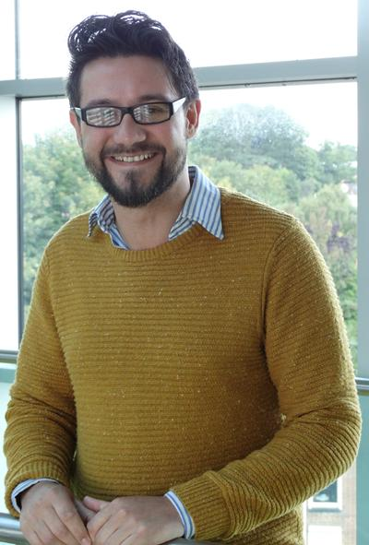
Who we are
Gavin Costigan
g.costigan@soton.ac.uk
023 8059 5836
Julie Cantalou
j.Cantalou@soton.ac.uk
023 8059 3518
Gareth Giles
g.giles@soton.ac.uk
023 8059 8981
http://www.southampton.ac.uk/publicpolicy/

Slide 10
Policy issues related to Modern Languages
Teaching of MFLs in schools
Languages for business
Teaching of English to non-native speakers
Provision of information and services in other languages
Role of English language in projection of UK internationally
Addressing Government’s own need for language skills
Non-language research

Slide 11
Policy issues related to Modern Languages
Teaching of MFLs in schools (Dept. for Education)
What to teach (what constitutes good level of achievement)
How to teach (evidence on how children learn languages)
Which languages to teach (European, Chinese, South Asian languages)

Slide 12
Policy issues related to Modern Languages
2. Languages for business (BIS, Home Office)
Ensuring workforce with right language skills
Pressure to employ overseas workers if insufficient UK workers with language skills
Certain sectors with high need for language skills
Provision of language teaching for adults

Slide 13
Policy issues related to Modern Languages
3. Teaching of English to non-native speakers (DfE, HO, BIS)
To children (in schools) - DfE
To adults (what provision of service?) - BIS
Migration, Integration, Citizenship – Home Office
Visas for international students – Home Office

Slide 14
Policy issues related to Modern Languages
4. Provision of information and services in other languages
Criminal Justice system (HO, DfJ)
Health service (DH)
Social & care services (DCLG, Local authorities)
Both what and how
What are the lessons from the Welsh?

Slide 15
Policy issues related to Modern Languages
5. Role of English language in projection of UK internationally
“British values” (FCO, British Council)
Culture & cultural industries (DCMS, UKTI)

Slide 16
Policy issues related to Modern Languages
6. Addressing Government’s own need for language skills
Diplomacy (FCO)
International Development (DfID)
EU Negotiation (many)

Slide 17
Policy issues related to Modern Languages
7. Non-language research
Anthropology – migration, refugees, international development (HO, FCO, DfID)
Culture and cultural relations – diplomacy (FCO), trade policy (BIS, UKTI)
Diasporas – cultural integration (HO/DCLG), trade & business (BIS, UKTI)
Heritage – Museums, tourism (DCMS)

