Slide 1
A Comparison of Functions in Middle School Textbooks among Finland, Singapore and Taiwan
Der-Ching Yang and Yung-Chi Lin
National Chiayi University, Taiwan (R.O.C)

Slide 2
Purpose
The purpose of this study was to examine the similarities and differences on the topic of functions among Finnish, Singaporean, and Taiwanese middle school mathematics textbooks

Slide 3
Introduction
Mathematics textbooks are generally agreed as an important resource in support of mathematics teaching and learning (Cai, Nie, & Moyer, 2010; Fan, Zhu, & Miao, 2013).
A fair number of researchers have shown their interest in comparing mathematics textbooks and discussing how textbooks affect mathematics teaching and learning (Senk, Thompson, & Wernet, 2014).
Students have difficulties in giving a proper definition for the concept of function and resolving problems on functions involving conversions between diverse modes of representation (Elia et al., 2006).

Slide 4
Introduction
The Finnish, Singaporean and Taiwanese textbooks were selected in this study because these three countries were usually thought as high performing countries in the international comparison tests, in particular in PISA).
There has already much research about textbooks comparison in East Asian countries and US (e.g., Hong & Choi, 2014) but there is relatively less research in East Asian and European countries.
We believe that cultural differences between these two regions will reflect on their textbooks and this will finally affect their mathematics teaching and learning.

Slide 5
Selected Textbooks
7th to 9th grade
Laskutaito mathematics textbooks (WSOY, 2009) in Finland,
New Syllabus mathematics textbooks (Teh & Loh, 2011) in Singapore
Kung Hsuan mathematics textbooks (Kang Hsuan Educational Published Group, 2012) in Taiwan

Slide 6
Problems Coverage
We coded all of the problems in the student textbooks, including:
worked examples (with solutions),
exercises (with no solutions)
summary test problems provided in the end of the textbooks chapter.

Slide 7
Analysis Framework
Topics: how many units and how the function is introduced
Representation Forms in problems,
purely mathematical form, verbal form, visual form, combined form
Context Types in problems
Application, non-application
Response Types in problems
Close-ended, open-ended
Cognitive Demand Types in problems
Memorization, Procedures without connections, Procedures with connections, Doing mathematics

Slide 8
Topics in textbooks
Finland (526 problems)
7th grade function machine (1 units included)
8th grade function machine (1 units included)
9th grade function machine, linear function and quadratic function (17 units included)
Singapore (121 problems)
7th grade Linear function (4 units included)
Taiwan (171 problems)
7th grade linear function (2 units included)
9th grade quadratic function (3 units included)

Slide 9
How the concept of function is introduced
Finnish textbooks: Function machine
Singaporean textbooks: Application problem
Taiwanese textbooks: Application problem

Slide 10
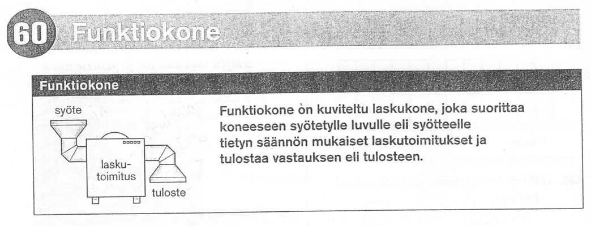
Finland 7th Grade (p.130)
The function machine is a visual calculator. When a number is put into the machine, the machine follows a rule of calculations to produce output number.

Slide 11
Finland 7th Grade (p.130)

Slide 12
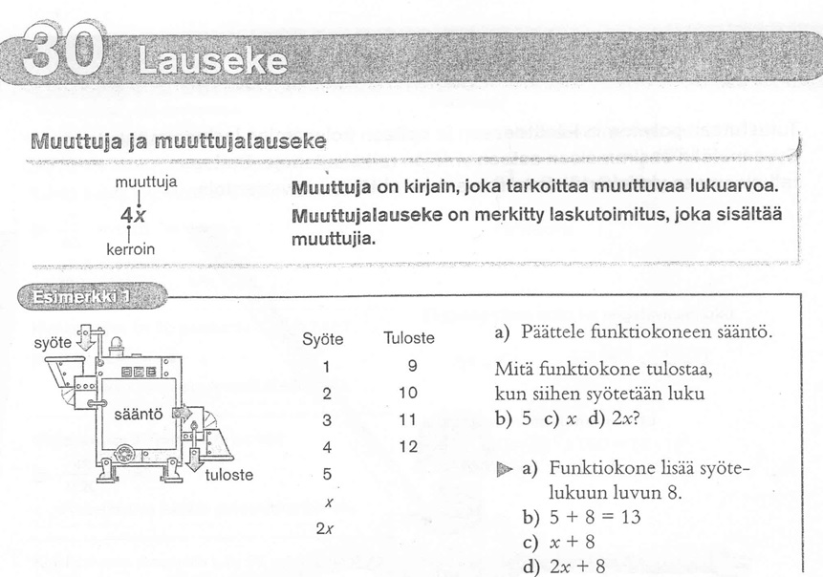
Finland 8th Grade (p.68)

Slide 13
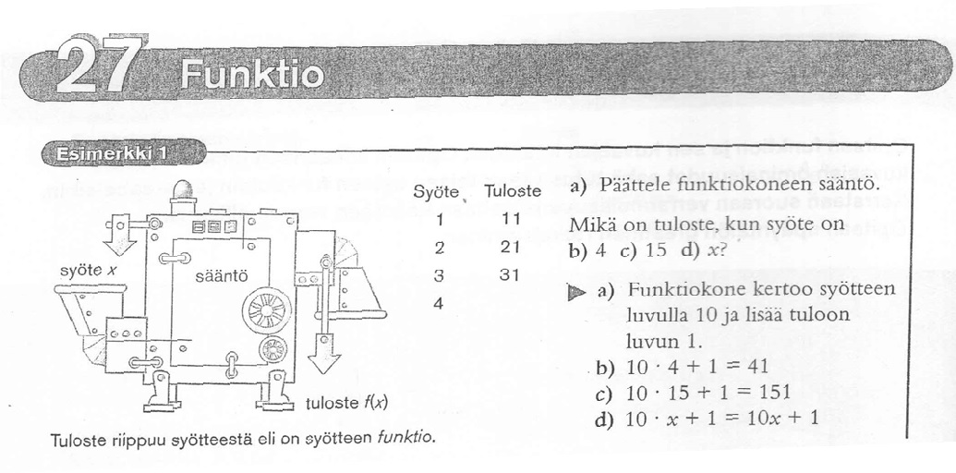
Finland 9th Grade (p.62)
the output depends on the input

Slide 14
Finland: The Definition of Function (9th grade , p.62)
Function f is a rule that for every value of x corresponds to exactly one value of the function f (x).

Slide 15
Three generations of the function machine
7th Grade
8th Grade
9th Grade
input
rule
output

Slide 16
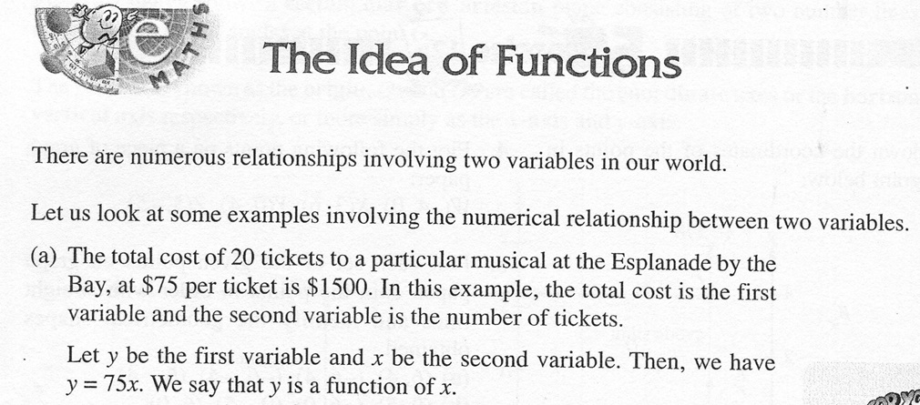
Singapore 7th Grade (p.273)

Slide 17
Singapore: The Definition of Function (7th grade , p.273)

Slide 18
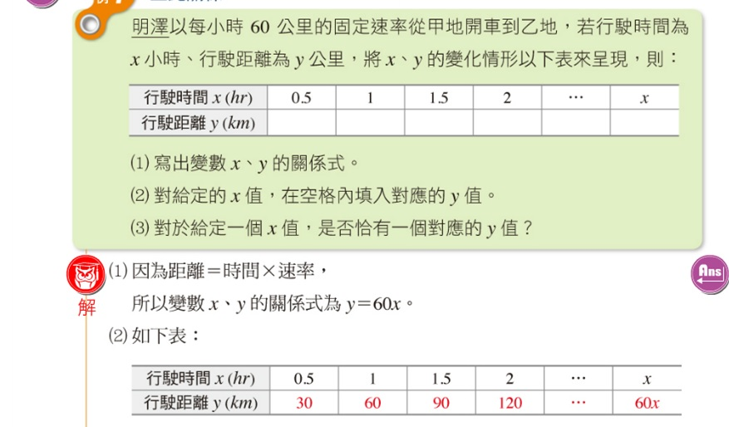
Taiwan 7th grade: A speed problem(p. 142)
Min drove a car from City A to City B in a fix speed. If the time is x hr; the distance is y km; the table below shows the relationship between x and y.
Write the relationship of x and y in the algebraic form
For any given x, please fill out the corresponding value of y in the table
For any given x, is there only a corresponding value of y?

Slide 19
Taiwan: The Definition of Function (7th grade , p. 144)
Previous examples all involve two variables. We use x and y to represent the two variables. When the value of x is specified, the value of y is then decided. That is:
For a given value of x, there is only one corresponding value of y. We say “y is a function of x”

Slide 20
Table 1. Distributions of problems in the representation form among three countries
Representation | Finland |  | Singapore |  | Taiwan
Form | N (526) | % | N (121) | % | N (171) | %
Purely math | 195 | 37.1% | 82 | 67.8% | 96 | 56.1%
Visual | 161 | 30.6% | 25 | 20.7% | 17 | 9.9%
Verbal | 121 | 23.0% | 13 | 10.7% | 30 | 17.5%
Combined | 49 | 9.3% | 1 | 0.8% | 28 | 16.4%

Slide 21
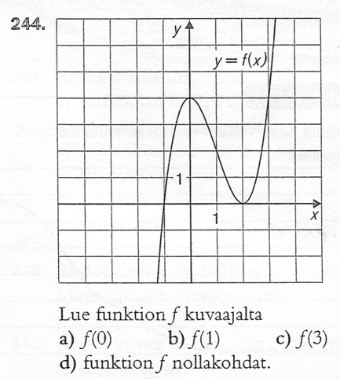
Finland: Visual form (9th grade, p.67)

Slide 22
Singapore: Purely math form (7th grade, p.274)

Slide 23
Taiwan: verbal form (7th grade, p. 145)
The relationship between Celsius and Fahrenheit is:
$The degree of Fahernheit=\frac{9}{5}×The degree of Celsius$, if let x be the degree
Of Celsius and y be the degree of Fahrenheit, is y a function of x?

Slide 24
Table 2: Distributions of problems in the context types among three countries
Context | Finland |  | Singapore |  | Taiwan
Types | N (526) | % | N (121) | % | N (171) | %
Application | 70 | 13.3% | 14 | 11.6% | 40 | 23.4%
Non-Application | 456 | 86.7% | 107 | 88.4% | 131 | 76.6%

Slide 25
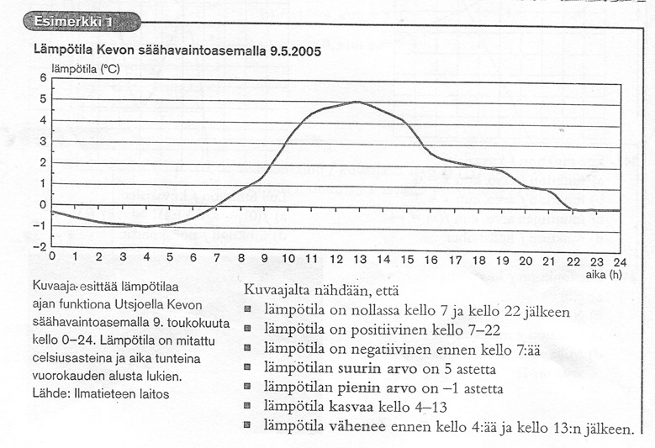
Finland: 9th grade (p.68)
Temperature from the Kevo weather station 09.05.2005
the temperature is zero at 7 o'clock and after 22 o'clock
temperature increases from 4 to 13 o’clock

Slide 26
Table 3: Distributions of problems in the response types among three countries.
Response | Finland |  | Singapore |  | Taiwan
Types | N (526) | % | N (121) | % | N (171) | %
Open-ended | 9 | 1.7% | 17 | 14.0% | 4 | 2.3%
Close-ended | 517 | 98.3% | 104 | 86.0% | 167 | 97.7%

Slide 27
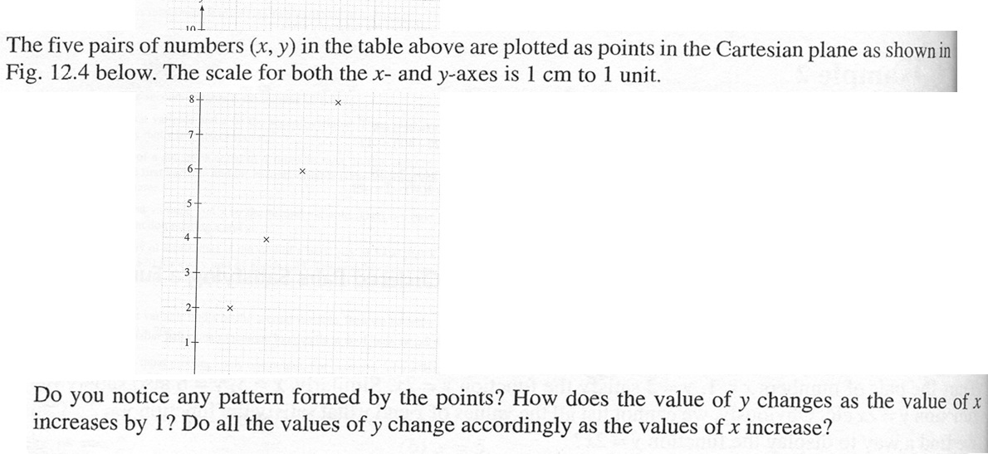
Singapore 7th grade (p. 275 )

Slide 28
Cognitive | Finland |  | Singapore |  | Taiwan
Demand | N (526) | % | N (121) | % | N (171) | %
Memorization | 74 | 14.1% | 0 | 0.0% | 4 | 1.9%
Procedures without connections | 256 | 48.7% | 56 | 46.3% | 59 | 34.2%
Procedures with connections | 193 | 36.7% | 48 | 39.7% | 86 | 50.9%
Doing mathematics | 3 | 0.6% | 17 | 14.0% | 22 | 13.0%

Slide 29
Taiwan: A problem in the Doing mathematics (9th grade, p.52)
There is a bridge. The arch of the bridge is a parabola.
The width of the river is 4 meters and the height is 2 meters.
When the water levels drop 1 meter, what is the width of the river?

Slide 30
Conclusion and Discussion
The Finnish textbooks much focus on visual representations.
Comparing to the two East Asian countries, the Finnish textbooks have more problems but these problems are more straightforward in terms of complexity than the East Asian countries.
The function machine has been recognized as a better way to introduce functions (Tall, McGowen, & DeMarois, 2000)
Visual presentations benefit students’ problem solving performance (Cai, 1995).
Various types of problems presented in a more balanced way may help students learn a concept more coherently (Zhu & Fan, 2006)

Slide 31
Thank you
Der-Ching Yang, dcyang@mail.ncyu.edu.tw
Yung-Chi Lin, b8524039@gmail.com

