Slide 1
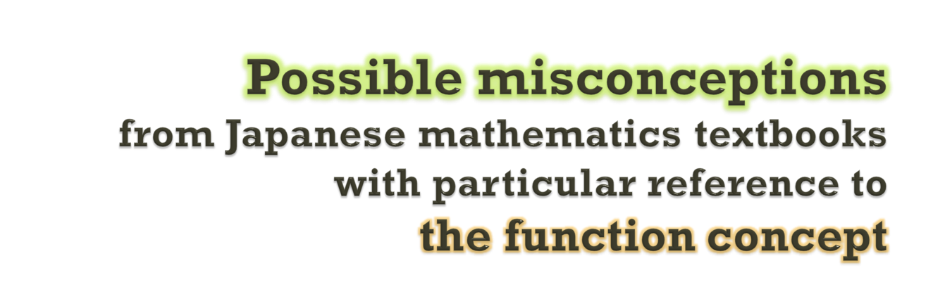

Abstract: Booklet p. 32

Slide 2
Contents
Introduction
Background
Theoretical Stance
Methodology
Result
Discussion

Slide 3

Introduction

Slide 4
Misconception & Textbook
Misconception
An erroneous guiding rule (Nesher, 1987)
For example, 0.24 > 0.6 because of the word lengths
Textbook
One of the important factors of what should be taught in mathematics.
One of the important factors of misconceptions?

Slide 5

Research Questions
Especially in this paper, we focus on the function concept in Japanese textbooks.
Do mathematics textbooks have an influence on students’ misconceptions?
(a)
What should the textbook writers pay attention to?
(b)

Slide 6

Background

Slide 7

Misconception for Functions
Some students think that a function must be represented by a single algebraic rule
(cf. Vinner and Dreyfus, 1989)
Single Algebraic Rule Conception

Slide 8
In Case of Japanese Students
Only 13.8% of Grade 9 students correctly distinguish a function from the other relationships in the National Assessment (MEXT & NIER, 2013).
One possible reason seemed to be that students are influenced by single algebraic rule conceptions.
MEXT = Ministry of Education, Culture, Sports Science & Technology
NIER = National Institute for Educational policy Research

Slide 9
Question in National Assessment
Which of the following items define y as a function of x ? Choose a correct one.
x is the number of students in a school and y m² is the area of its schoolyard;
x cm² is the area of the base of a rectangular parallelepiped and y cm³ is its volume;
x cm is the height of a person and y kg is his/her weight;
a natural number x and its multiple y;
an integer x and its absolute value y.
(MEXT & NIER, 2013, p. 64, translated by the author)
5.3%
34.1%
9.9%
35.3%
13.8%

Slide 10
Why Can’t Distinguish?
MEXT & NIER’s suggestions
The formula for the area of a rectangular parallelepiped
The word multiple with proportional functions
Influence of single algebraic rule misconceptions?
proportional functions?

Slide 11
Theoretical Stance

Slide 12

Coordinating Two Perspectives
We should view the various co-existing perspectives as sources of ideas to be adapted (Cobb, 2007).
Following Cobb (1994), the constructivist and the sociocultural perspectives are coordinated.
Constructivist perspective: Gray & Tall (1994)
Sociocultural perspective: Lave & Wenger (1991)

Slide 13
Focus on Actual Encapsulation
Gray & Tall (1994)
Whether an appropriate process is encapsulated into a new conception, or not.
Lave & Wenger (1991)
In what community of practice the students actually participate.
Coordinating both ideas:
Focus on what process is actually encapsulated into a new conception.

Slide 14
Specific Research Question
It is expected that an inappropriate process will be encapsulated into a misconception.
What process may students experience when they read the Japanese textbook writings about functions?
(a)
What is the difference between the predicted conceptions and the intended function concept?
(b)

Slide 15

Methodology

Slide 16
Textbook Selection
In Japan, the word function is defined twice, at junior high school & at high school.
Students may use the different textbook series at junior high school & at high school.
We selected the two textbooks.
Keirinkan (2012); For junior high school.
Suken Shuppan (2011); For high school.
Each is one of the representative textbooks at each school level in Japan.

Slide 17

Analysis
We basically followed the way of Thompson’s (2000) conceptual analysis.
What does each word in the target sentences imply?
We interpreted what the textbook writings might implicitly encourage students to do.

Slide 18
Result

Slide 19
What Textbooks Encourage To Do
Keirinkan (2012): Both of (A) & (B)
Suken Shuppan (2011): Only (B)
To formularize some relationships between x and y
(A)
(B)
To repeat to fix x and calculate y

Slide 20
Example of Textbook Descriptions
Question in Keirinkan (2012)
On what quantity the following quantities depend?: the length of the horizontal sides of the squares whose area is 24cm²
Example in Suken Shuppan (2013)
Let y cm be the perimeter of the square whose sides have x cm. Then, y = 4x, and y is a function of x, where x > 0.
To formularize some relationships between x and y
To repeat to fix x and calculate y

Slide 21

Discussion

Slide 22
Two Possible Conceptions
Formularizable function conception
From the encapsulation of the process (A)
Calculable function conception
From the encapsulation of the process (B)
To formularize some relationships between x and y
(A)
(B)
To repeat to fix x and calculate y

Slide 23
The Concept Will Not Arise
General Function
Calculable Function
Formularizable Function
Two possible conceptions are subsets of the general function concept.

Slide 24
Why Not Arise? - Hypothesis
The examples in the textbooks are regarded not as ones randomly chosen from the set of all functions.
But rather as ones randomly chosen from the set of all formularizable or calculable functions, at least, from students’ perspective.
Insufficiency of subjective randomness

Slide 25

“Good” Examples of Functions
Not always have mathematically good properties
i.e., calculability or formularizability
Rather may have even mathematically bad properties
i.e., difficulties in calculating or formularizing
Nevertheless, for this reason, tend to engage students to focus only on the essence of the function concept.
Such examples will increase the sufficiency of subjective randomness.

Slide 26
Implication
Imagine an actual situation where we want to use the function concept.
We should follow:
Intuitive feeling that there may be a function in the situation.
Logical judgment whether it is really a function or not.

Slide 27


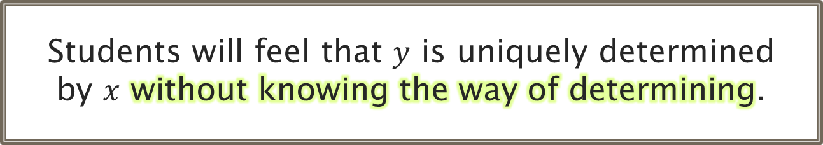
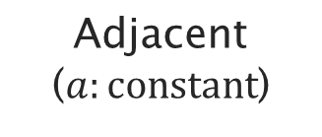

Possible Example
Relationship between opposite ($x$) and hypotenuse ($y$) of a right-angled triangle.
Before learning Pythagorean theorem
Students will feel that $y$ is uniquely determined by $x$ without knowing the way of determining.
Hypotenuse ($y$)
Opposite ($x$)
Adjacent ($a:constant$)

Slide 28
Conclusion
The textbooks seem to lack the sufficient subjective randomness for the construction of the function concept.
Only biased processes are provided for the encapsulation.
“Good” examples are needed in the textbooks.
Future task:
To analyse the case of the other textbooks, and to discuss what examples the students need
To discuss the meaning of mis-conceptions.

Slide 29
Conclusion
The textbooks seem to lack the sufficient subjective randomness for the construction of the function concept.
Only biased processes are provided for the encapsulation.
“Good” examples are needed in the textbooks.
Future task:
To analyse the case of the other textbooks, and to discuss what examples the students need
To discuss the meaning of mis-conceptions.
Thank you for your attention!
Yusuke Uegatani
y-uegatani@hiroshima-u.ac.jp

Slide 30
Supplement

Slide 31
Interpretations of Keirinkan
 | Writings in the textbook (translated by the author) | Interpretation
1 | [Question] On what quantity the following quantities depend? // (1) the length of the horizontal sides of the squares whose area is 24cm2, // (2) the total weight of the bucket and the water in it, where the weight of the bucket is 700g, // (3) the distance you have walked in case you walk 70m per minute. | The question encourages students to formularize each relationship (1), (2), and (3).
2 | For example, in the above question (1), the length of the horizontal sides changes according that of the vertical sides. If the length of the vertical sides is determined, then that of the horizontal sides is uniquely determined. | The example encourages students to fix the length of the vertical sides and to calculate that of the horizontal sides.
3 | [Example 1: the opened area of a window] We open the window whose horizontal sides have 90cm. The opened area of the window changes according to the length we slide the window. If the length is determined, then the area is uniquely determined. // In the above Example 1, let x cm be the length we slide the window, y cm2 be its opened area. x and y change according to each other, and they can take various values. | The example encourages students to fix the slid length, and to calculate the opened area.
[ “//” means a paragraph break]

Slide 32
4 | [Definition ] … if there are two variables x and y which change according to each other, and if when we determine the value of x, the value of y is uniquely determined according to the value of x, // then we say that y is a function of x. | The writings determine the way of judging whether something is a function or not.
5 | In Example 1, there is the relationship y = 90x between x and y. // Like this, if y is a function of x, there are cases where the relationship can be represented by the formula. | The writings encourage students to reflect on the formalizing process.
6 | [Question 1] Which is the case where y is a function of x? // (1) You go from the city A to the city B, which is 30km far. The reached distance x km, and the remaining distance y km. // (2) You pour water into a tank, 4L per minute. The amount of water y L per x minutes. // (3) A person’s age x and he or her height y cm. // (4) The radius of a circle x cm and its area y cm2. | The writings encourage students to try to formalize each relationship. If they succeed in formalizing, then they will fix x and calculate y, and notice the relationship is a function. If they fail to formalize, then they notice it is not a function
[ “//” means a paragraph break]

Slide 33
Interpretation of Suken Shuppan
 | Writings in the textbook (translated by the author) | Interpretation
1 | [Definition] For two variables x and y, if when we determine the value of x, the value of y is uniquely determined, then we say that y is a function of x. | The writings determine the way of judging whether something is a function or not.
2 | [Example 1] Let y cm be the perimeter of the square whose sides have x cm. Then, y = 4x, and y is a function of x, where x > 0. | The writings encourage students to fix the value of x and to calculate the value of 4x.
3 | [Example 2] Let y cm² be the area of the square whose sides have x cm. Then, y = x², and y is a function of x, where x > 0. | The writings encourage students to fix the value of x and to calculate the value of x².

