Slide 1
INTEGRATED EDUCATION AT PRIMARY SCHOOLS IN LITHUANIA
Saulius Žukas
Baltos Lankos publishing house
Ričardas Kudžma
Vilnius University, Lithuania

Slide 2
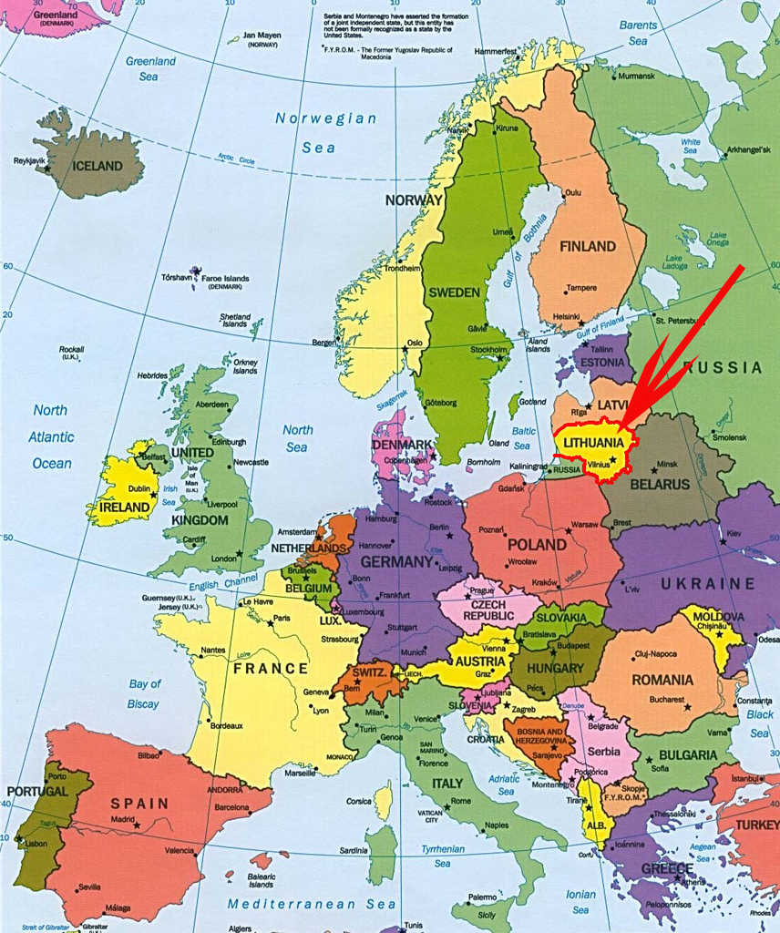


LITHUANIA
Populiation ~ 3 million
Area - 65,300 km²
Capital – Vilnius
National language - Lithuanian
Member of EU
since 2004

Slide 3
Integrated primary school textbook “VAIVORYKŠTĖ”*
*”Vaivorykštė” in english means Rainbow. Hereinafter – “Vaiva”
Today's global challenges mean that the autonomous approach to the educational content of each discipline must be changed in favour of providing possible interdisciplinary connections.
We offer a concept covering the full cycle of primary education and its realisation in a set of primary-school textbooks called “Vaiva” that connects the following disciplines: introduction to the world, native language, mathematics, arts and crafts, music, dance, and ethics. Our textbooks are based on the integration of thematic affinities, but we are not limited to this.

Slide 4

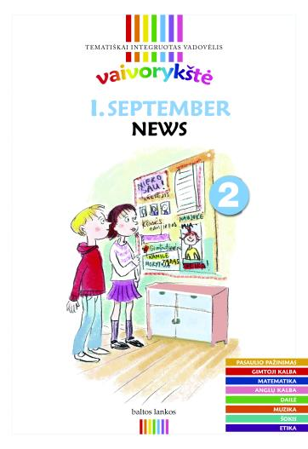
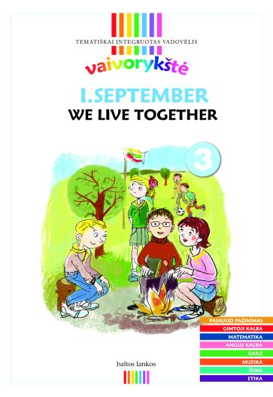
Integrated primary school textbook “VAIVORYKŠTĖ”

Slide 5
The transition from a distribution of cognitive disciplines, traditionally used in schools, to multidisciplinary integration and a holistic understanding of the world requires theories that declare a more universal way of perceiving the world. One of these is semiotics, which becomes an invisible background to our integration concept.
Our concept is based on the Paris school of semiotics, where the world is seen as a meaningful whole. It is interested in value formation and its functioning in a particular cultural context and focuses on discourse, rather than on the analysis of signs.
Traditional school subjects can be considered as ways of looking at the world, the means of understanding and describing it. Semiotics sees these as “languages” in the broad sense.

Slide 6
Disciplines in the textbook “Vaivorykštė”
Introduction to the world
Native language (Lithuanian)
Mathematics
English language (starts from 2nd grade)
Music
Dance
Arts and crafts
Ethics

Slide 7
Certain content can be translated from one language to another. Translation can be called a transformation or conversion (Duval (2006)), while transcoding is a more common word in semiotics.
Mathematicians, apparently, are interested in the accuracy of content conversion. However, semiotics, when talking about transcoding, highlights the increase of knowledge, acquired during the translation from one language to another. A. J. Greimas generally argues that the values appear during the transcoding (Greimas (1970).

Slide 8
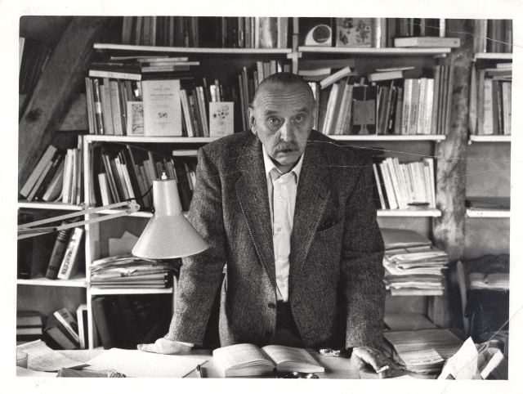
„ Mathematicians, apparently, are interested in the accuracy of content conversion. However, semiotics, when talking about transcoding, highlights the increase of knowledge, acquired during the translation from one language to another.“
A. J. Greimas (1917 – 1992)

Slide 9
A simple example of a transcode. The primary education programme requires teaching about trees:
  In the knowledge of the world lessons, including knowledge about nature, students look at: what tree it is, where it grows, what conditions are needed for its growth, why leaves drop, how people use it, the structure of a tree;
  from the mathematical aspect: wood thickness, height; width and depth of the roots, the amount of fruit, growth rate and fruit yield predictions;
  from the aspect of native language: stories about a tree, the symbol of a World Tree;
  from the aspect of art: wood as an aesthetic object;
  from the aspect of music: songs about a tree;
  from the aspect of ethics: environmental problems and so on.

Slide 10
There is no doubt that such a grouping of the different disciplines into one theme shape a tree as a multidimensional object of understanding. This all leads to a holistic understanding of the world being formed in the minds of children.
In traditional teaching, trees would also be discussed, but in different classes, and certainly not at the same time. Practice shows that in integrated teaching students learn more in a broader context, and in greater depth.

Slide 11
Our set of textbooks is based on the principle of thematic connection. We divided the teaching materials dictated by the introduction to the world into nine topics of more abstract months. These themes, depending on the amount of school weeks, were divided into three or four more specific topics accordingly
During a school year, we cover about 30 similar themes; during the four years of primary education we cover up to 130 themes.
Each of these specific topics, in turn, becomes the pivot around which all the disciplines of formal education revolve. So our goal was to combine the two grids: the introduction to the world dictated the topics of conversation, and each discipline, consistent with this topic, sought their own methodological purposes.

Slide 12

Weekly topics
Let‘s introduce
My family
How to cross the street
My school

Slide 13
Introduction to the world
Native language
Mathematics
English language
Arts and crafts
Music
Dance
Ethics

Slide 14
Grade I January – “Wheel of time”
Introduction to the world. The principles of timing (seconds, minutes, hours, days, etc.), the history of clocks, types of clocks, elementary antique clocks structure (sun, sand, mechanical and other clocks) are discussed.
Native language. How to say, how to ask the time.
Mathematics. How to count seconds, minutes, hours, how to add, subtract.
Design and Technology. What clocks can look like; students create a paper clock and decorate it.
Music. By comparing the rhythm of different time units and different musical rhythms, the pulse of the music is analysed (dainoje valandų ritmas tampa bokšto laikrodžiu, minučių ritmas – namų laikrodžiu, sekundžių – rankiniu laikrodėliu).
Dance. The rhythm of different time units, as discussed in the music lessons, becomes the basis for creating a dance with three rhythms.
Ethics. What a schedule means, why it is inappropriate to be late, how you feel if you are late.

Slide 15
In the discussion of the transfer of information at the train station, we saw that the information senders want to transmit the same information in different ways, in different “languages”, including different sensory channels (visual, auditory). Meanwhile, when we talk about the transition of different rhythms of the clock (seconds, minutes and hours) to the rhythm of music or dance, we already have a clear increase of knowledge – the perception of time helps to understand the different nature of music and dance rhythms.

Slide 16
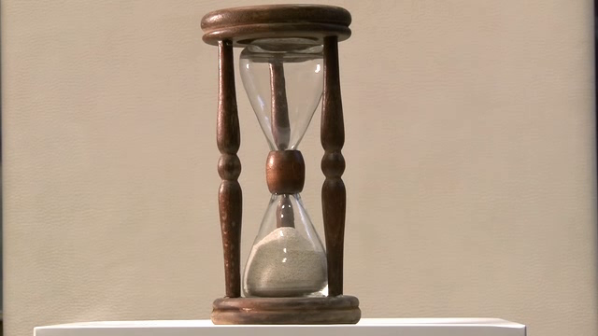
Hourglass

Slide 17
Teaching to understand the flow of time, count time is associated with ambiguity, which is not easy for children to understand. At first, counting is learned in the decimal system, while time is calculated in the sixty decimal, though the same numbers are added and subtracted. Things get more complicated during sports events, for example, swimming, when time is counted in a mixed system, i.e. both in minutes, seconds and in tenths and hundredths of a second.

Slide 18
Currently, the education process is increasingly focused on problematical reasoning and problem-solving skills. Real life problems presented to students will be complex and syncretic in nature, while different disciplinary skills must be used to find the solutions. One of the key principles of problematic reasoning is the understanding that there are several possible solutions to any one problem.
How to create this corpus of opportunities? Typically, this problem-solving method involves brainstorming. It can be enriched with integrated educational opportunities. Students could be encouraged to look at alternate ways of perceiving the same object or phenomena in various disciplines.

Slide 19
Finally, we would like to emphasise that interchanging different points of view or cognitive strategies is highly productive in a creative sense. Creative thinking in any activity is based on the juxtaposition of different contexts and on the invention of the denominator or common denominator connecting those contexts.

Slide 20
In our case, the basis of the connector is the common discussion topic, allowing combining or even merging different areas of knowledge, or school disciplinary contexts, while moving from one context to another we can talk about the increase of value as a result of transcoding.

Slide 21
Thank you

