Slide 1
International Conference on Mathematics Textbook Research and Development 2014 University of Southampton, UK 29-31 July 2014

Slide 2
Model Method in Singapore Primary Mathematics Textbooks
Dr Kho Tek Hong, Maths Education Consultant, Singapore
Dr Yeo Shu Mei, Ministry of Education, Singapore
Prof Fan Lianghuo, University of Southampton, UK

Slide 3
Outline
Singapore Mathematics Textbooks
Solving Word Problems Using the Model Method
Model Method and Algebra
Implications on Mathematics Curriculum and Textbooks

Slide 4
Singapore Mathematics Textbooks

Slide 5
Education in Singapore
Survival driven 1959 – 1978
Efficiency driven 1978 – 1996
Ability driven 1997 – 2011
Student-centric values driven 2012 -
Mathematics syllabuses:
1978, 1990, 2000, 2006, 2012
Each was followed by new textbooks.
Notes:
The New Education System (NES) in 1979 is a major landmark.
The Curriculum Development Institute of Singapore (CDIS) was set up in 1980 to develop textbooks and instructional packages in order to improve the teaching and learning in schools.

Slide 6
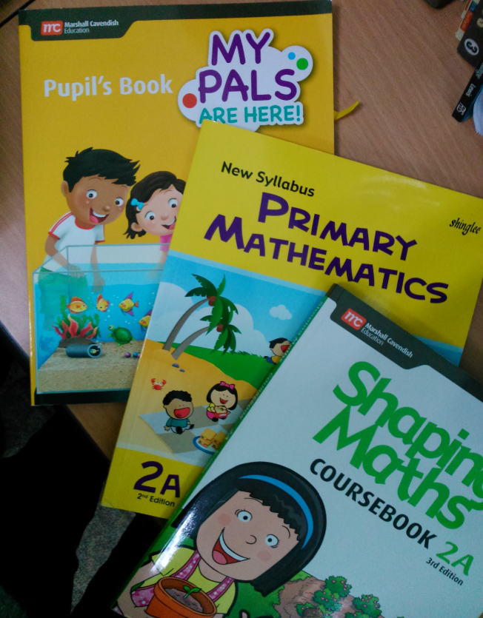
Singapore Mathematics Textbooks

Slide 7
Singapore students had difficulties in understanding and solving mathematics word problems. It was for this reason that the model drawing method, or simply the model method, was introduced by the CDIS Primary mathematics project team in the 1980s.

Slide 8
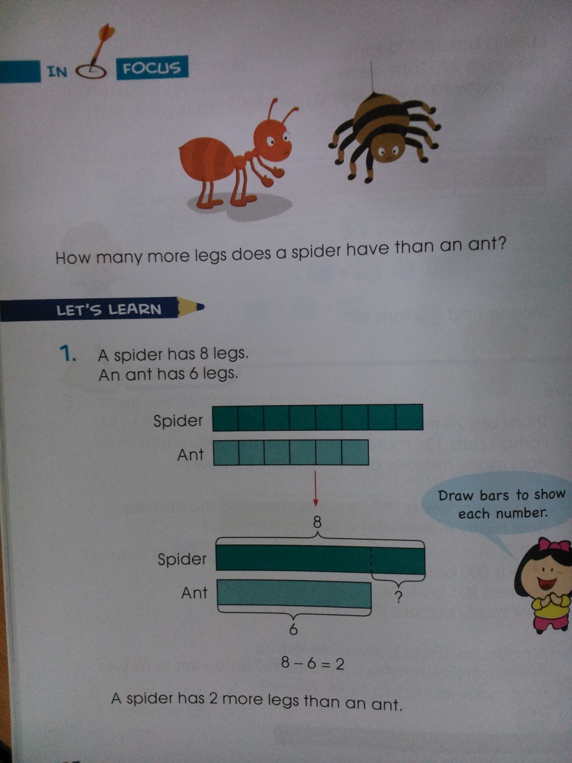
The model method has become a feature of Singapore primary mathematics textbooks.

Slide 9
Solving Word Problems Using the Model Method

Slide 10
This monograph serves as a resource book on the Model Method. The main purpose is to make explicit how the model method is used to develop students’ understanding of fundamental mathematics concepts and proficiency in solving basic mathematics word problems.

Slide 11
The part-whole and comparison models are pictorial forms of Greeno’s part-part-whole and comparison schemas for addition and subtraction word problems. These schemas represent the conceptual structures of addition and subtraction word problems.

Slide 12
Part-whole model for addition and subtraction
Whole
Part 1
Part 2
The model represents a quantitative relationship among three variables: whole, part1 and part2. Given the values of any two variables, we can find the value of the third one by addition or subtraction.

Slide 13
Comparison model for addition and subtraction
Difference
Smaller quantity
Larger quantity
The model represents a quantitative relationship among three variables: larger quantity, smaller quantity and difference. Given the values of any two variables, we can find the value of the third one by addition or subtraction.

Slide 14
In the Singapore primary mathematics textbooks, the part-whole and comparison models were further developed to include multiplication and division, as well as fraction, ratio, and percentage.

Slide 15
Part-whole model for multiplication and division
The following part-whole model represents a whole divided into 3 equal parts:
Whole
Part
The model illustrates the concept of multiplication as:
×
Number of parts
=
One part
Whole

Slide 16
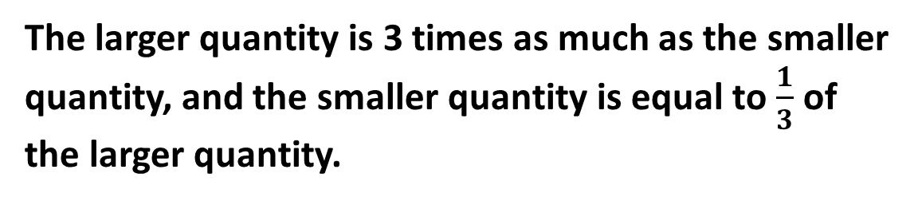
Multiplicative comparison models
One quantity is a multiple of the other, e.g.
Larger quantity
Smaller quantity
The larger quantity is 3 times as much as the smaller quantity, and the smaller quantity is equal to $\frac{1}{3}$ of the larger quantity.

Slide 17
Ratio models
The following part-whole model shows a whole divided into three parts A, B, and C in the ratio 2:3:4.
Whole
Part A
Part B
Part C
The following comparison model shows three quantities A, B, and C which are in ratio 2:3:4.
Quantity A
Quantity B
Quantity C
The ratio 2:3:4 means “2 units to 3 units to 4 units”.

Slide 18
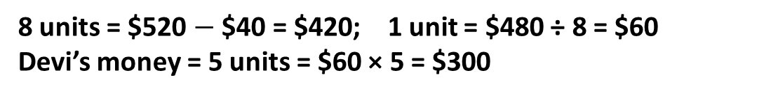
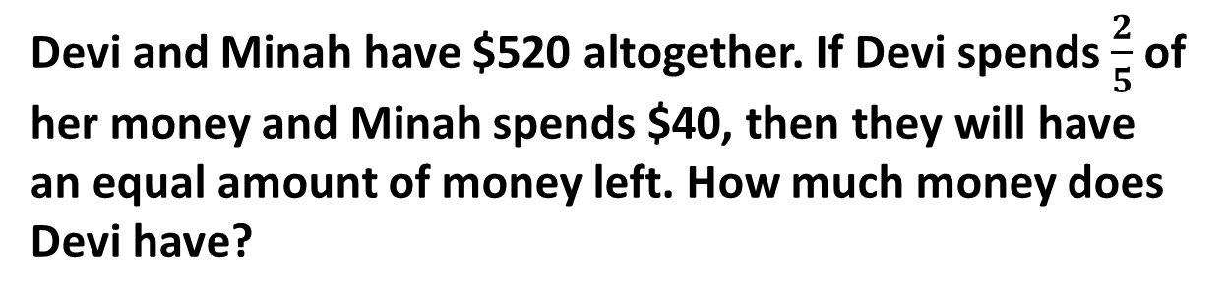
Devi and Minah have $520 altogether. If Devi spends $\frac{2}{5}$ of her money and Minah spends $40, then they will have an equal amount of money left. How much money does Devi have?
Variation 1
The model represents the after and before situations of the problem.
After
Devi
Minah
Before
1 unit
Devi
$520
Minah
$40
8 units = $520 $−$ $40 = $420; 1 unit = $480 ÷ 8 = $60
Devi’s money = 5 units = $60 × 5 = $300

Slide 19
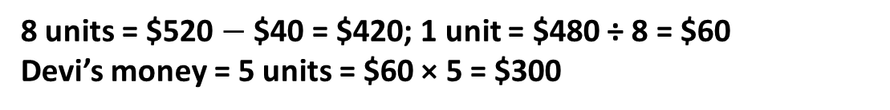
Devi and Minah have $520 altogether. If Devi spends $\frac{2}{5}$ of her money and Minah spends $40, then they will have an equal amount of money left. How much money does Devi have?
Variation 2
1 unit
Devi
$520
Minah
3 units
$40
8 units = $520 $−$ $40 = $420; 1 unit = $480 ÷ 8 = $60
Devi’s money = 5 units = $60 × 5 = $300

Slide 20
When students solve a problem by drawing a part-whole or comparison model, they consciously make use of the problem schema to visualise the problem structure, make sense of the quantitative relationship in the problem, and determine what operation (addition, subtraction, multiplication, or division) to use to solve the problem.

Slide 21
Model Method and Algebra

Slide 22
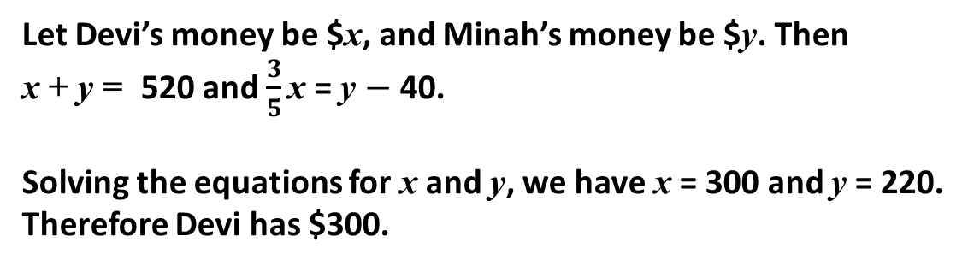
Devi and Minah have $520 altogether. If Devi spends $\frac{2}{5}$ of her money and Minah spends $40, then they will have an equal amount of money left. How much money does Devi have?
Variation 3
Let Devi’s money be $x, and Minah’s money be $y. Then
x + y = 520 and $\frac{3}{5}\text{x}$ = y $−$ 40.
Solving the equations for x and y, we have x = 300 and y = 220. Therefore Devi has $300.

Slide 23
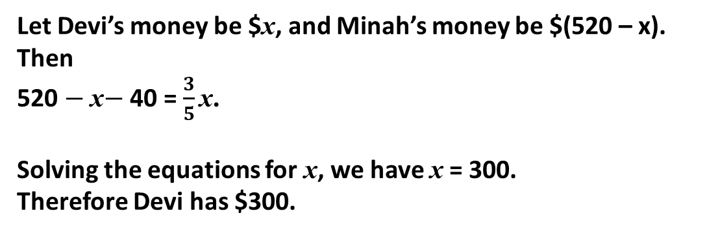
Devi and Minah have $520 altogether. If Devi spends $\frac{2}{5}$ of her money and Minah spends $40, then they will have an equal amount of money left. How much money does Devi have?
Variation 4
Let Devi’s money be $x, and Minah’s money be $(520 – x). Then
520 $−$ x$−$ 40 = $\frac{3}{5}\text{x}\text{.}$
Solving the equations for x, we have x = 300.
Therefore Devi has $300.

Slide 24
In Singapore, students learn linear equations in one variable at Secondary One (the 7th grade), and simultaneous linear equations at Secondary Two. Many of them have difficulty in formulating the equation(s) and continue to use the model method instead of the algebraic method to solve problems.

Slide 25
It is therefore necessary to integrate the model method with the algebraic method to bridge the cognitive gap from arithmetic to algebra.

Slide 26
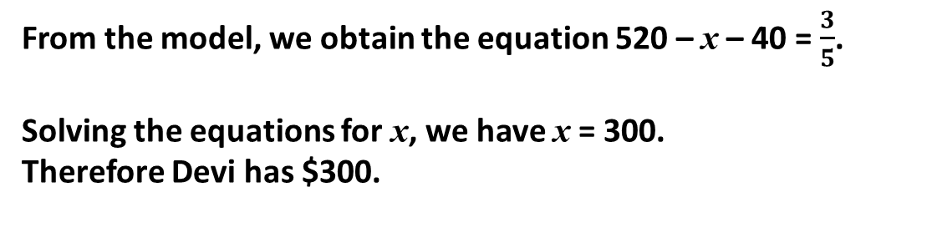
Devi and Minah have $520 altogether. If Devi spends $\frac{2}{5}$ of her money and Minah spends $40, then they will have an equal amount of money left. How much money does Devi have?
Variation 5
Devi
x
520
Minah
520 - x
From the model, we obtain the equation 520 – x – 40 = $\frac{3}{5}$.
Solving the equations for x, we have x = 300.
Therefore Devi has $300.

Slide 27
Devi and Minah have $520 altogether. If Devi spends $\frac{2}{5}$ of her money and Minah spends $40, then they will have an equal amount of money left. How much money does Devi have?
Variation 6
x
520
3x
40
From the model, we obtain the equation 8x + 40 = 520.
Solving the equations for x, we have x = 60.
Therefore Devi has $300.

Slide 28
Implications on Mathematics Curriculum and Textbooks

Slide 29
The Concrete-Pictorial-Abstract (CPA) approach is a pedagogy adopted by Singapore primary mathematics textbooks since the early 1980s. The bar model is a visual aid, and students are not required to describe the model or to explain how it is constructed.

Slide 30
The use of the model method to solve mathematics word problems has been explicitly included as part of Learning Experiences in the latest national primary and secondary mathematics syllabuses.

Slide 31
Word problem
Pictorial model
Solution
Algebraic equation
When students use the model method to solve a problem, they draw a model and use it to work out the arithmetic steps to find the answer.
Notes:
When students use the algebraic method to solve a problem, they formulate an algebraic equation from the problem text and solve the equation to find the answer.

Slide 32
Word problem
Pictorial model
Solution
Algebraic equation
When students use the algebraic method to solve a problem, they formulate an algebraic equation from the problem text and solve the equation to find the answer.

Slide 33
Word problem
Pictorial model
Solution
Algebraic equation
When the model method is integrated with the algebraic method, students first draw a model and use it to formulate the algebraic equation. This approach has been incorporated in the latest secondary mathematics textbooks.

