Slide 1

Textbook use in England: Mining
OFSTED reports for views
on mathematics textbooks
Christian Bokhove & Keith Jones
Southampton Education School, University of Southampton
July 29th, 2014

Slide 2
It has been suggested that OFSTED holds particular views on textbook use in that it opposes an ‘over-reliance’ on textbooks, claiming that “in over a third of classes there was an over-reliance upon a particular published scheme” and that this “usually led to pupils spending prolonged periods of time in which they worked at a slow pace, often on repetitive, undemanding exercises, which did little to advance their skills or understanding of number, much less their interest and enthusiasm for mathematics” (OFSTED, 1993, p. 16).

Slide 3
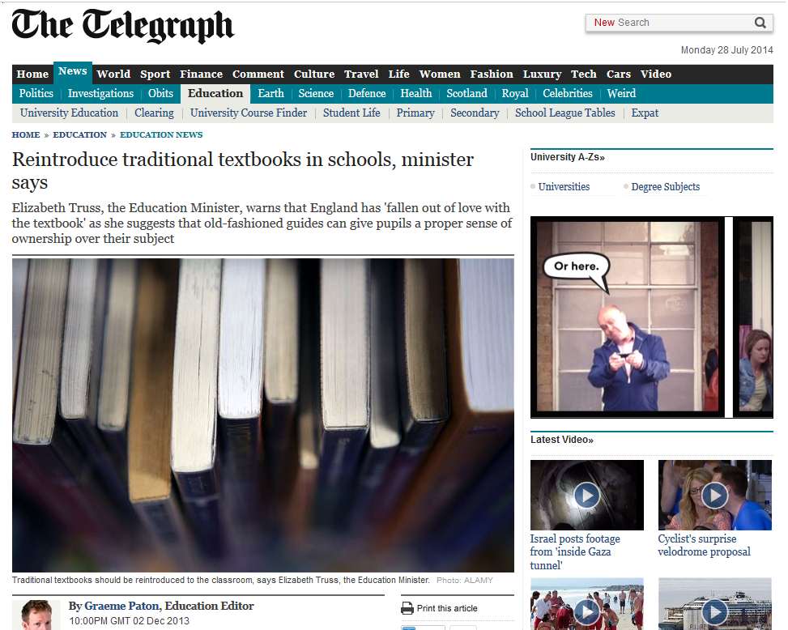
http://www.telegraph.co.uk/education/educationnews/10489675/Reintroduce-traditional-textbooks-in-schools-minister-says.html

Slide 4
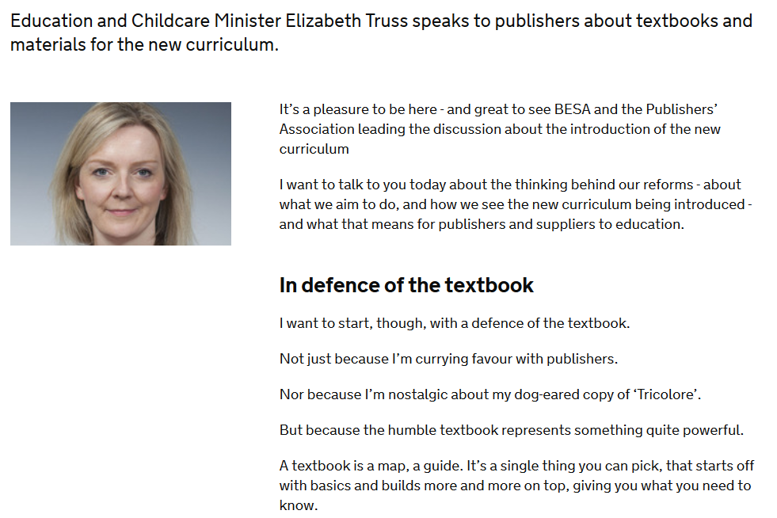
https://www.gov.uk/government/speeches/elizabeth-truss-speaks-to-education-publishers-about-curriculum-reform

Slide 5
Methodology
The procedure that was used for data mining was loosely based on the ‘knowledge discovery in data’ methodology using The Cross Industry standard Process for Data Mining (CRISP-DM, Bosnjak, Grljevic & Bosnjak, 2009). CRISP-DM distinguishes several phases that could be applied to the web as well.
Organizational Understanding, concerns an understanding of the website.
Data Understanding, would involve knowing the precise format of the data.
Data Preparation, the data is transformed into a format that is understandable for the tool that will perform the analyses.
Modelling, is the phase that is used for the actual analyses.
Evaluation, determines the truthfulness and usefulness of the analysis results.
Deployment, could involve the distribution and publication of the results of the analyses, as is done in this presentation, and therefore not explicitly mentioned.

Slide 6
1. Organizational Understanding
OFSTED provides publicly-available inspection reports for every school (http://www.ofsted.gov.uk/ ).
Every report has a judgment attached to it which is mentioned on the website and within the report itself. The current judgments are: grade 1 (outstanding), grade 2 (good), grade 3 (requires improvement) and grade 4 (inadequate). Before January 2012 grade 3 (requiring improvement) was called ‘satisfactory’. The website also has interim reports. Our focus: secondary education.

Slide 7
2. Data Understanding
Most recent reports
  1786 schools, 20 no report, 1766 most recent reports of which
  Good 854
  Inadequate 149
  Outstanding 236
  Requires Improvement 480
  Satisfactory 47
First went for ‘inspection reports’ but
  Poor inspection results, more visits, more reports
  So decided to go for all publicly published inpsection reports, interim reports and letters

Slide 8
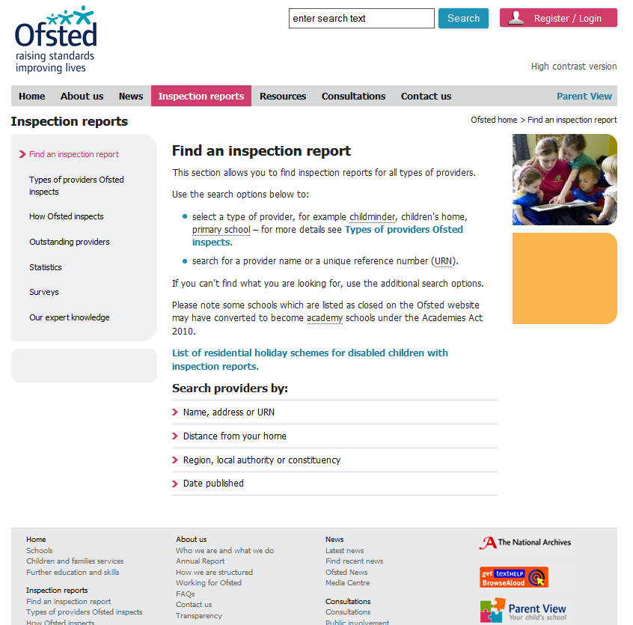

Slide 9
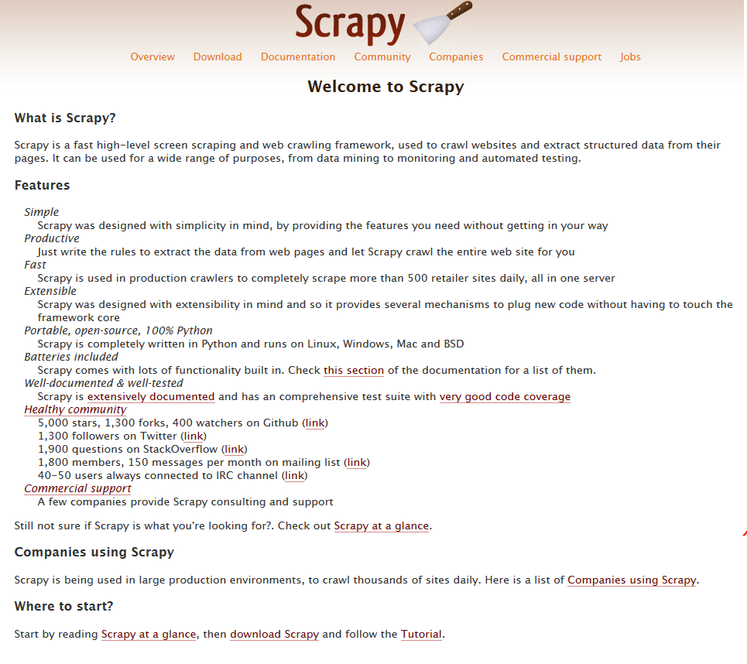
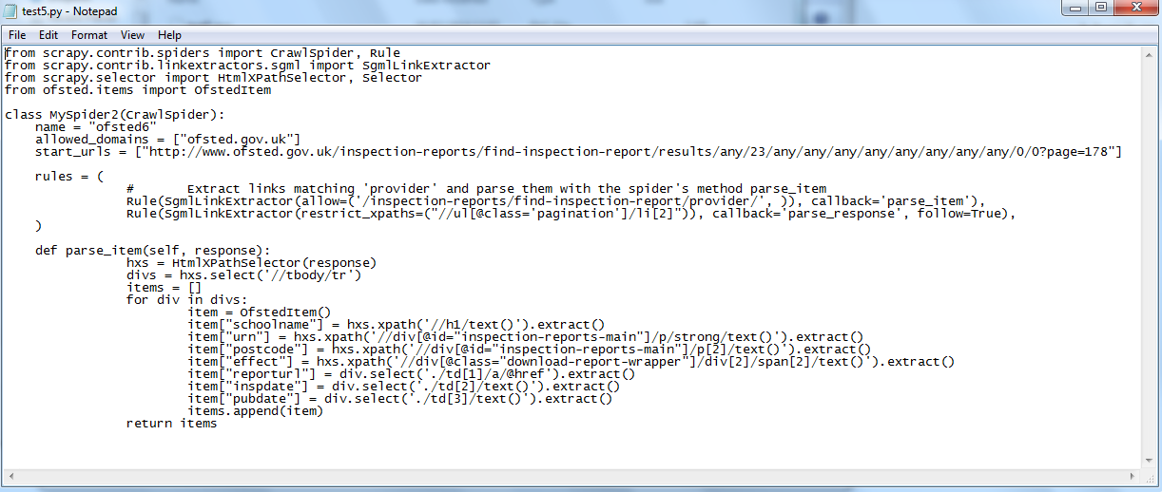

Slide 10
Year | Reports | Size *) | Avg | Med | Min | Max
2000 | 212 | 34.2 MB | 171 | 158 | 91 | 1257
2001 | 278 | 38.7 MB | 101 | 99 | 65 | 347
2002 | 178 | 30.5 MB | 114 | 100 | 79 | 822
2003 | 190 | 33.7 MB | 118 | 99 | 72 | 1409
2004 | 274 | 35.4 MB | 137 | 94 | 51 | 1192
2005 | 302 | 51.1 MB | 120 | 73 | 13 | 1178
2006 | 639 | 58.2 MB | 106 | 26 | 10 | 2566
2007 | 884 | 122 MB | 61 | 27 | 7 | 1975
2008 | 835 | 132 MB | 42 | 29 | 6 | 1042
2009 | 896 | 128 MB | 43 | 30 | 2 | 439
2010 | 1062 | 150 MB | 36 | 26 | 10 | 286
2011 | 1139 | 193 MB | 39 | 26 | 8 | 800
2012 | 1000 | 175 MB | 29 | 22 | 4 | 212
2013 | 1481 | 239 MB | 28 | 22 | 9 | 974
2014 | 189 **) | 7.17 MB | 35 | 31 | -1 ***) | 120
TOTAL | 9559 | 1.39 GB
*) Rounded off
**) Up until Feb 15th, 2014
***) This is an error that appeared on the website:

Slide 11
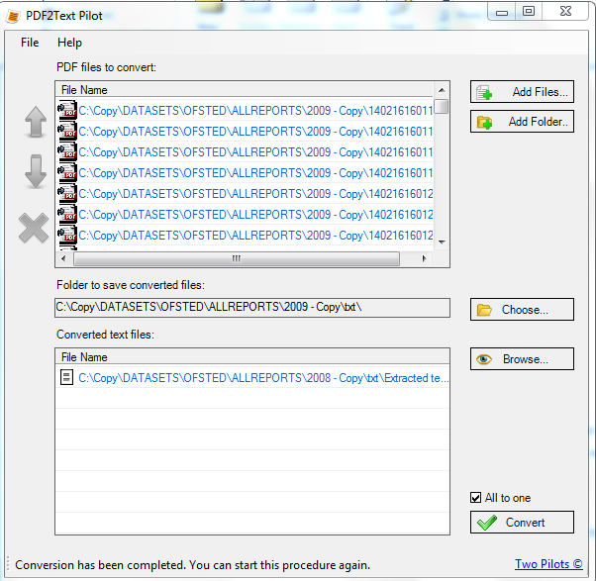
3. Data Preparation
Dataset A
PDF converted to
plain text format
Three sets
  2000-2004
  2005-2009
  2010-March 2014
Two subject reports
reports added

Slide 12
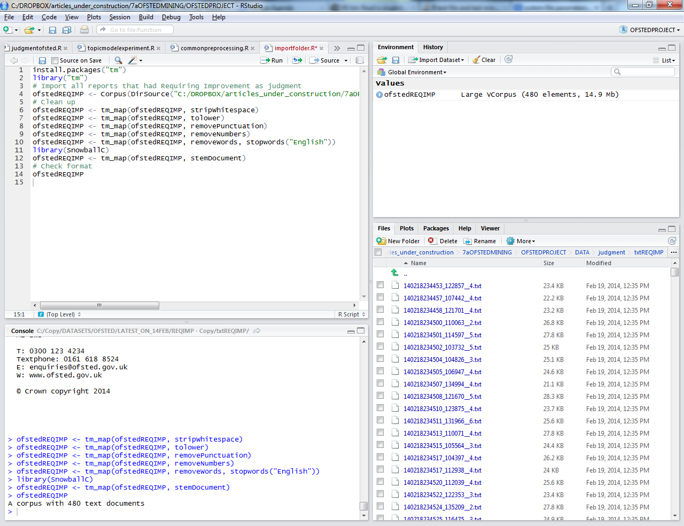
3. Data Preparation
Dataset B. For 2004, 2008
and 2013
Imported into Rstudio
tm package in R for
textmining
Three corpora
  Making all characters lower case.
  Removing punctuation marks from a text document.
  Removing any numbers from a text document.
  Removing English stopwords.
  Stripping extra whitespace from the documents.
  Document-Term Matrix

Slide 13
Challenges in data preparation
File errors
Strange symbols
Protected pdf files

Slide 14
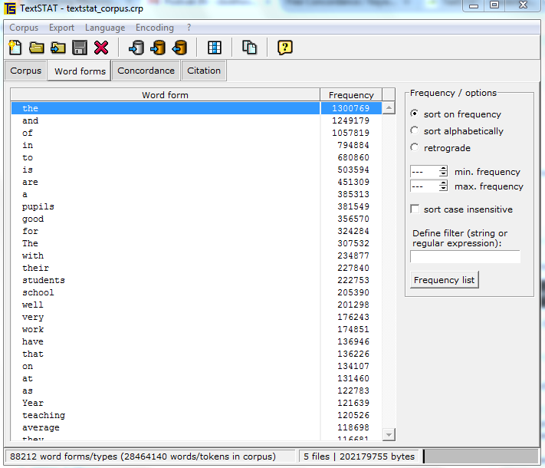
4. Modelling
With dataset A
- textStat (version 2.9c)

Slide 15
4. Modelling
With dataset B

Slide 16
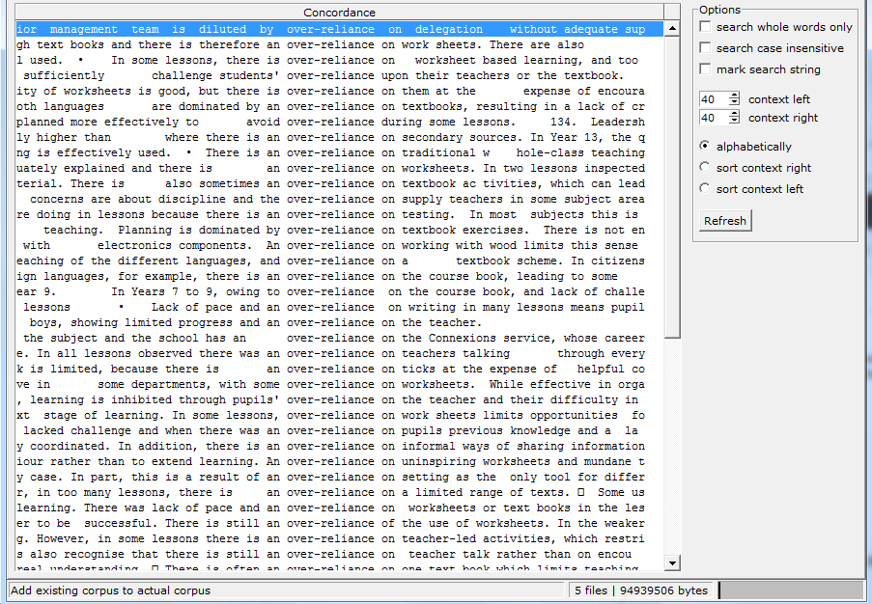
5. Evaluation
With dataset A

Slide 17
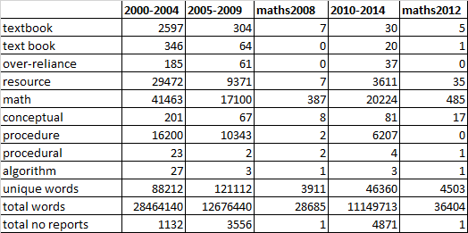
5. Evaluation
Interpretation is difficult
Table 2: frequencies for the corpora

Slide 18
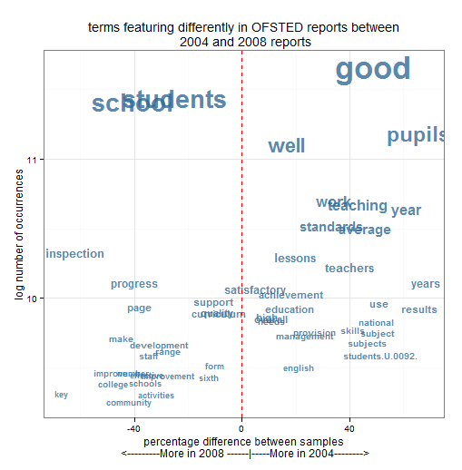
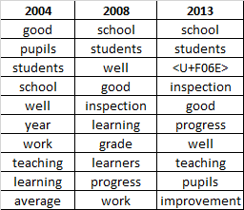
5. Evaluation

Slide 19
Future work
Extend to more sophisticated text analyses methods
  Rstudio can do much more textmining techniques: K-means clustering, topic modelling, Latent Dirichlet Allocation
Differences between judgments
Link to other largescale datasets like TIMSS and PISA

Slide 20
Link to other datasets
Throughout the years England has internationally scored relatively high on non-textbook use and using textbooks as a supplement rather as primary source.
This holds for both year 4 and year 8, but there seems to be more textbook use in secondary school year 8 than primary school year 4.
In year 4, between 2003 and 2007 the international average stayed the same while England seemed to use fewer textbooks and more as a supplement. For 2011 this is hard to say because of changing metrics but it is clear that it still is way above the international average with again year 4 even more pronounced than year 8.
Over time the relative position of England in this respect has gone done from roughly number 5 to number 1. In other words, England is the country that seems to use textbooks least of all participating countries in TIMSS 2011.

Slide 21
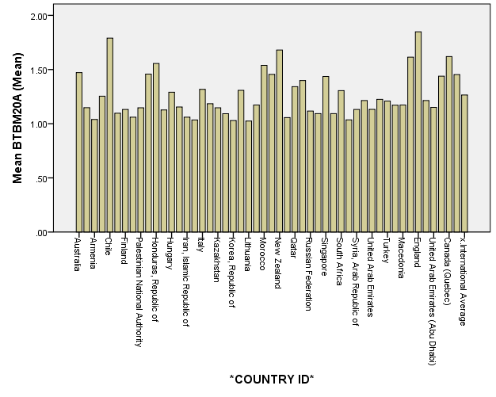
.
Figure 1: bar chart of textbook use in year 8 of TIMSS 2011 data

