Slide 1
Authoring Your OWN creative, electronic book for mathematics: the MC-squared project
Christian Bokhove & Keith Jones
Southampton Education School, University of Southampton
Patricia Charlton, Manolis Mavrikis & Eirini Geraniou Institute of Education, University of London
July 30th, 2014
The research leading to these results has received funding from the European Union Seventh Framework Programme (FP7/2007-2013) under grant agreement n° 610467 - project “M C Squared”. This publication reflects only the author’s views and Union is not liable for any use that may be made of the information contained therein.
Notes:
The EU-funded‘MC-squared’ project is working with a number of European communities to develop digital, interactive, creative, mathematics ‘textbooks’ that the project calls ‘cBooks’. The cBooks are authored in a Digital Mathematics Environment in which participants can construct books with various interactive ‘widgets’. This paper provides an outline of the MC-squared project illustrating an interactive storyboard of the Digital Mathematics Environment architecture. This includes examples of how authoring by cBook designers of interactive ‘widgets’ is possible. The workshop that relates to this paper is augmented, of course, by suitable ‘hands-on’ materials aimed at two possible cBooks: one focusing on aspects of geometric and spatial thinking using building blocks, the other on aspects of number and fractions.

Slide 2
14:00-14:10 | Introduction MC-squared project Technology Communities of Interest and Boundary Crossing Social Creativity and Creative Mathematical Thinking (SC and CMT)
14:10-14:30 | ‘Challenge eliciting activity’
14:30-14:40 | DME demo Workshop paper DME manual
14:45-15:20 | Brief of the task: ‘Play’ with DME and try making some c-book pages or modify existing c-books on either geometric and spatial thinking using building blocks, the other on aspects of number and fractions.
15:20-15:45 | Share each other’s ‘products’. Discuss in pairs. Try out CoiCode Focus of the discussion: Being aware of some of the features of the c-book environment what, in your opinion, information as a teacher would you need about the student (his/her use of the c-book)?
15:45-16:00 | Exchange experiences. Wrap up session.

Slide 3
Overview project
Design and develop a new genre of authorable e-book, which we call 'the c-book' (c for creative)
Creative Mathematical Thinking (CMT)
Initiate a ‘Community of Interest’ (CoI) (Fischer, 2001)
A community of interest consists of several stakeholders from various ‘Communities of Practice’ (Wenger, 1998).
England, Spain, Greece, France
Within these teachers who co-design and use resources for teaching, can contribute to their own professional development (e.g., Jaworski, 2006).
Social Creativity (SC)
Boundary crossing
Creative Mathematical Thinking (CMT)
UK CoI: learning analytics

Slide 4
How the UK CoI works…

Slide 5
14:00-14:10 | Introduction MC-squared project Technology Communities of Interest and Boundary Crossing Social Creativity and Creative Mathematical Thinking (SC and CMT)
14:10-14:30 | ‘Challenge eliciting activity’
14:30-14:40 | DME demo Workshop paper DME manual
14:45-15:20 | Brief of the task: ‘Play’ with DME and try making some c-book pages or modify existing c-books on either geometric and spatial thinking using building blocks, the other on aspects of number and fractions.
15:20-15:45 | Share each other’s ‘products’. Discuss in pairs. Try out CoiCode Focus of the discussion: Being aware of some of the features of the c-book environment what, in your opinion, information as a teacher would you need about the student (his/her use of the c-book)?
15:45-16:00 | Exchange experiences. Wrap up session.

Slide 6
14:00-14:10 | Introduction MC-squared project Technology Communities of Interest and Boundary Crossing Social Creativity and Creative Mathematical Thinking (SC and CMT)
14:10-14:30 | ‘Challenge eliciting activity’
14:30-14:40 | DME demo Workshop paper DME manual
14:45-15:20 | Brief of the task: ‘Play’ with DME and try making some c-book pages or modify existing c-books on either geometric and spatial thinking using building blocks, the other on aspects of number and fractions.
15:20-15:45 | Share each other’s ‘products’. Discuss in pairs. Try out CoiCode Focus of the discussion: Being aware of some of the features of the c-book environment what, in your opinion, information as a teacher would you need about the student (his/her use of the c-book)?
15:45-16:00 | Exchange experiences. Wrap up session.

Slide 7
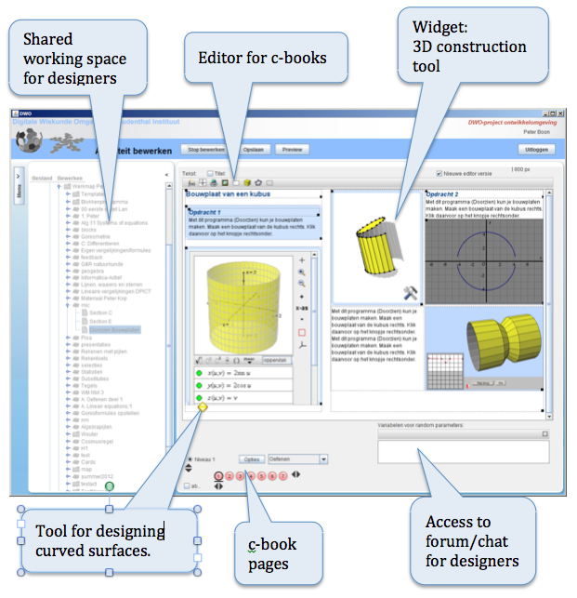

Slide 8
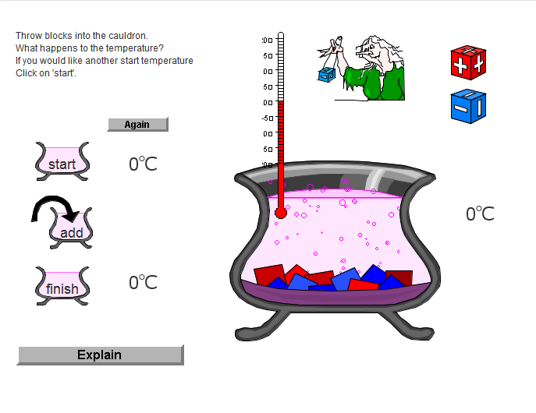
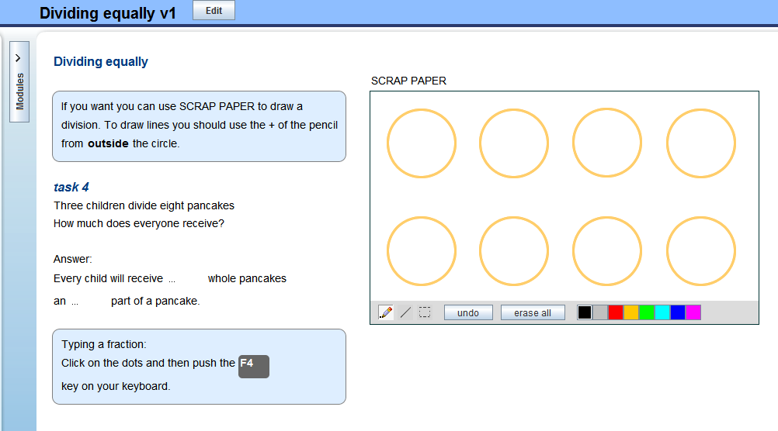
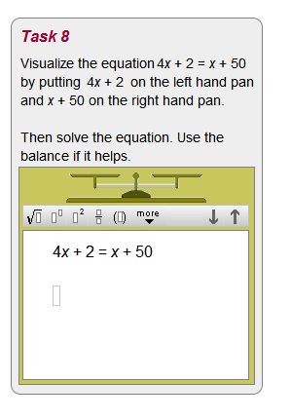
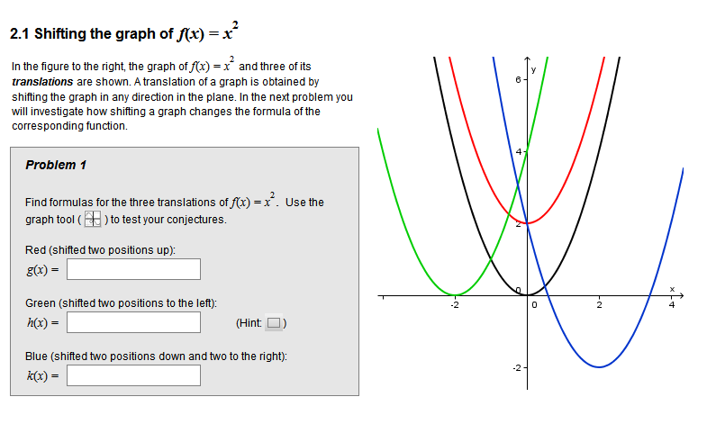
Other cBook ideas

Slide 9
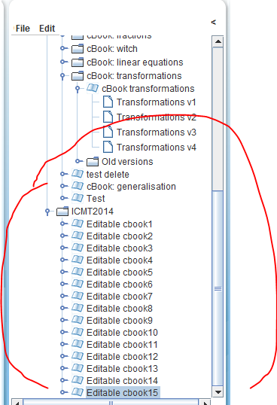
Go to:
http://mc2dme.appspot.com/mcs/
Login with:
icmt<number> with <number> a number designated to you
Password the same.
WORK IN THE FOLDER ICMT14 ‘Editable cbook<number>’

Slide 10
14:00-14:10 | Introduction MC-squared project Technology Communities of Interest and Boundary Crossing Social Creativity and Creative Mathematical Thinking (SC and CMT)
14:10-14:30 | ‘Challenge eliciting activity’
14:30-14:40 | DME demo Workshop paper DME manual
14:45-15:20 | Brief of the task: ‘Play’ with DME and try making some c-book pages or modify existing c-books on either geometric and spatial thinking using building blocks, the other on aspects of number and fractions. JAVA!
15:20-15:45 | Share each other’s ‘products’. Discuss in pairs. Try out CoiCode Focus of the discussion: Being aware of some of the features of the c-book environment what, in your opinion, information as a teacher would you need about the student (his/her use of the c-book)?
15:45-16:00 | Exchange experiences. Wrap up session.

Slide 11
14:00-14:10 | Introduction MC-squared project Technology Communities of Interest and Boundary Crossing Social Creativity and Creative Mathematical Thinking (SC and CMT)
14:10-14:30 | ‘Challenge eliciting activity’
14:30-14:40 | DME demo Workshop paper DME manual
14:45-15:20 | Brief of the task: ‘Play’ with DME and try making some c-book pages or modify existing c-books on either geometric and spatial thinking using building blocks, the other on aspects of number and fractions.
15:20-15:45 | Share each other’s ‘products’. Discuss in pairs. Try out CoiCode Focus of the discussion: Being aware of some of the features of the c-book environment what, in your opinion, information as a teacher would you need about the student (his/her use of the c-book)?
15:45-16:00 | Exchange experiences. Wrap up session.

Slide 12
14:00-14:10 | Introduction MC-squared project Technology Communities of Interest and Boundary Crossing Social Creativity and Creative Mathematical Thinking (SC and CMT)
14:10-14:30 | ‘Challenge eliciting activity’
14:30-14:40 | DME demo Workshop paper DME manual
14:45-15:20 | Brief of the task: ‘Play’ with DME and try making some c-book pages or modify existing c-books on either geometric and spatial thinking using building blocks, the other on aspects of number and fractions.
15:20-15:45 | Share each other’s ‘products’. Discuss in pairs. Try out CoiCode Focus of the discussion: Being aware of some of the features of the c-book environment what, in your opinion, information as a teacher would you need about the student (his/her use of the c-book)?
15:45-16:00 | Exchange experiences. Wrap up session.

Slide 13
More on research tomorrow

