Slide 1
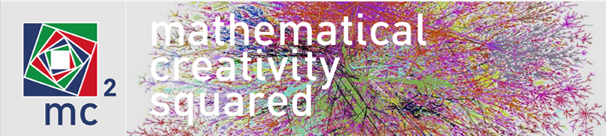
Co-designing electronic books:
Boundary objects for social creativity
Christian Bokhove & Keith Jones
Southampton Education School, University of Southampton
Patricia Charlton, Manolis Mavrikis & Eirini Geraniou
Institute of Education, University of London
July 31th, 2014
The research leading to these results has received funding from the European Union Seventh Framework Programme (FP7/2007-2013) under grant agreement n° 610467 - project “M C Squared”. This publication reflects only the author’s views and Union is not liable for any use that may be made of the information contained therein.
Notes:
The EU-funded‘MC-squared’ project is working with a number of European communities to develop digital, interactive, creative, mathematics ‘textbooks’ that the project calls ‘cBooks’. The cBooks are authored in a Digital Mathematics Environment in which participants can construct books with various interactive ‘widgets’. This paper provides an outline of the MC-squared project illustrating an interactive storyboard of the Digital Mathematics Environment architecture. This includes examples of how authoring by cBook designers of interactive ‘widgets’ is possible. The workshop that relates to this paper is augmented, of course, by suitable ‘hands-on’ materials aimed at two possible cBooks: one focusing on aspects of geometric and spatial thinking using building blocks, the other on aspects of number and fractions.

Slide 2
Aims
Design and develop a new genre of authorable e-book, which we call 'the c-book' (c for creative)
  Creative Mathematical Thinking (CMT)
Initiate a ‘Community of Interest’ (CoI) (Fischer, 2001)
  A community of interest consists of several stakeholders from various ‘Communities of Practice’ (Wenger, 1998).
  England, Spain, Greece, France
  Within these teachers who co-design and use resources for teaching, can contribute to their own professional development (e.g., Jaworski, 2006).
  Social Creativity
UK CoI: learning analytics

Slide 3
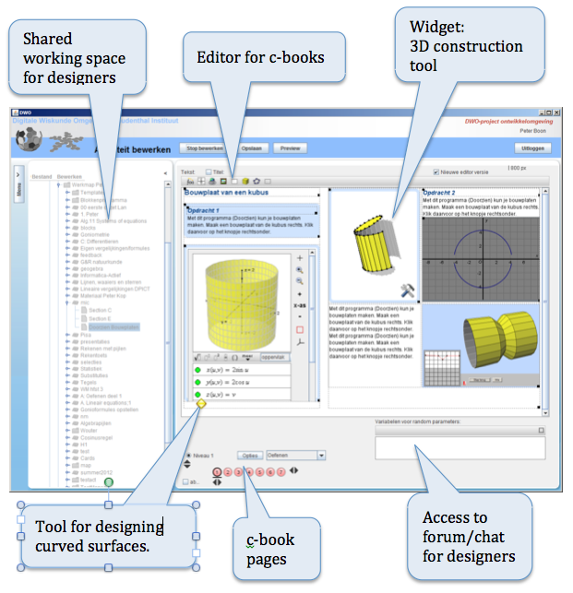
Edit the book

Slide 4
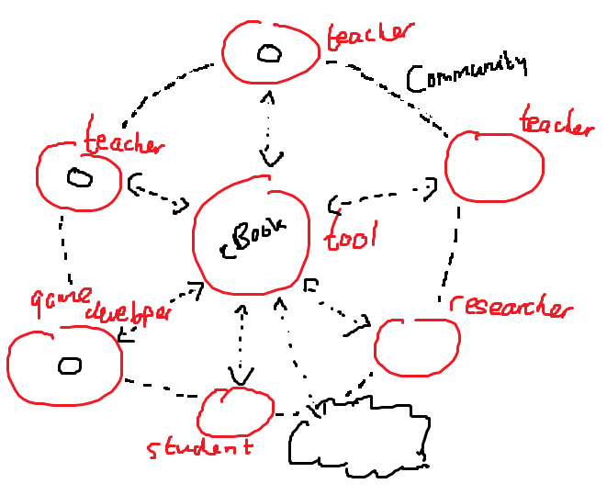

Slide 5
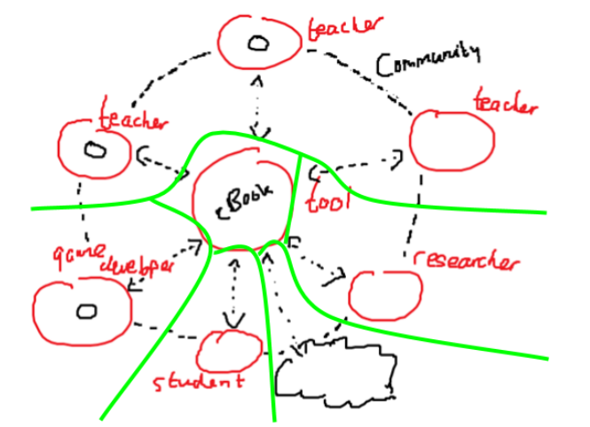

Slide 6
cBooks are boundary objects
Boundary crossing
A boundary is defined as "a socio-cultural difference leading to discontinuity in action of interaction (e.g., Bernstein, 1971; Engeström, Engeström, & Kärkkäinen, 1995; Star, 1989; Suchman, 1994)".
“Where two worlds meet”
Not only cBook interesting but process as well.

Slide 7
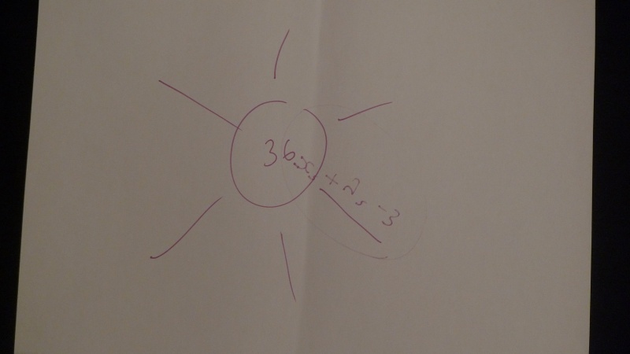
Simple example: cBook on numbers
1. First idea: the number 36

Slide 8
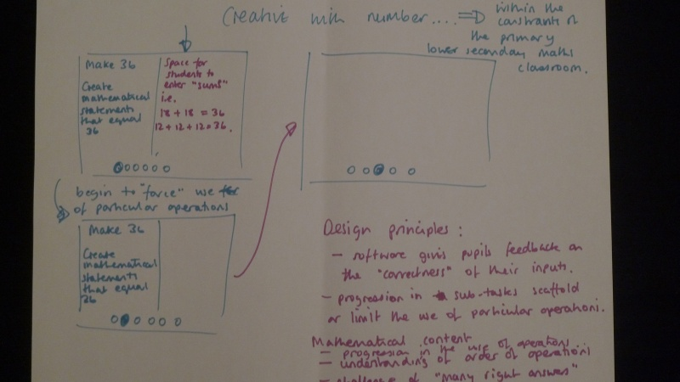
2. Expanding the idea

Slide 9
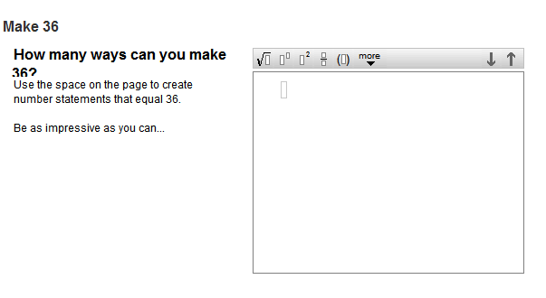
3. First prototype

Slide 10
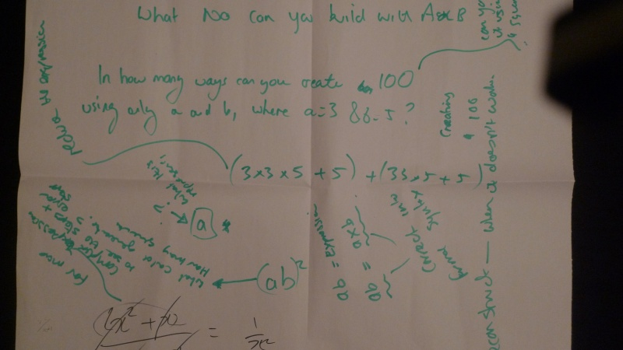
4. Parallel idea involved expressions

Slide 11
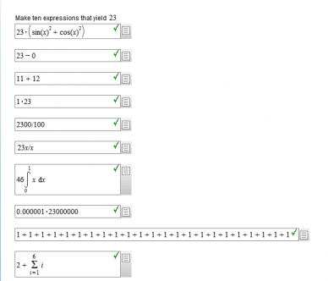
5. Developing the first prototype

Slide 12
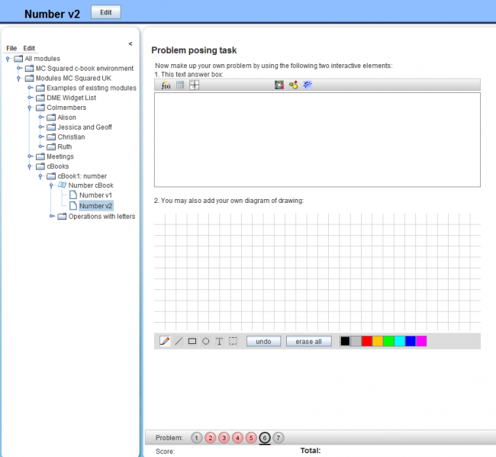
6. Adding open expression element for pupils

Slide 13
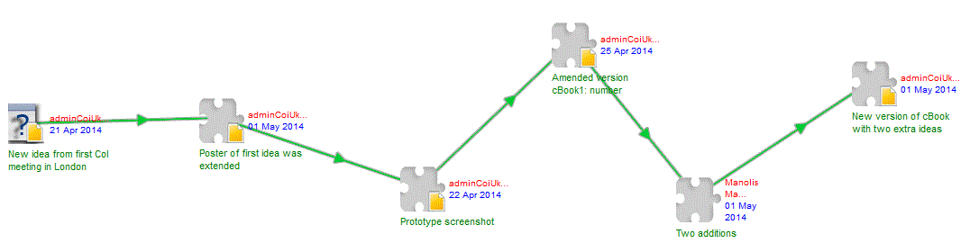
Demo CoIcode
Capturing communication

Slide 14
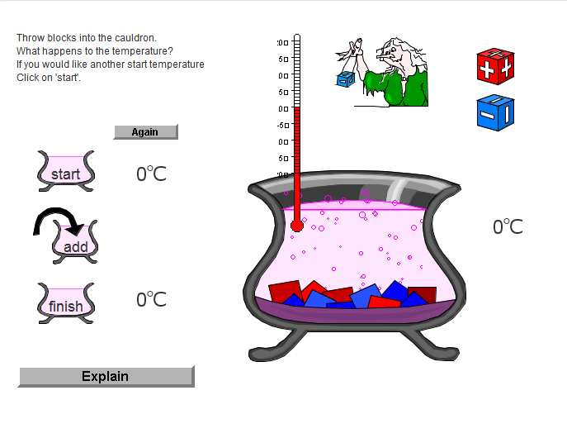
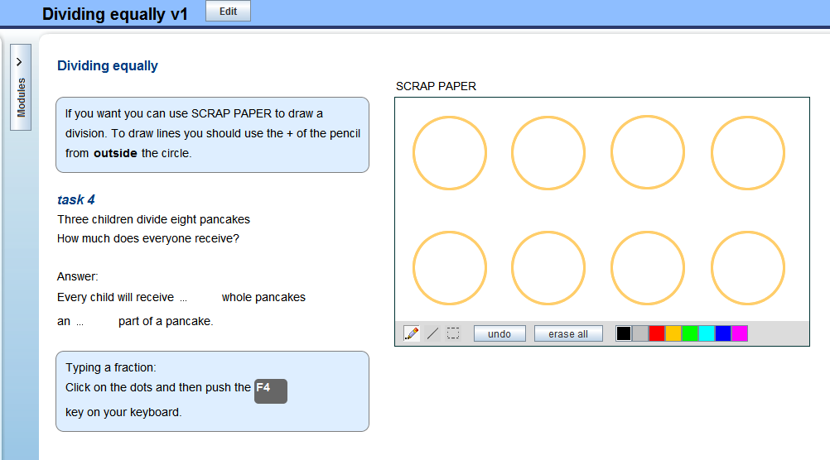
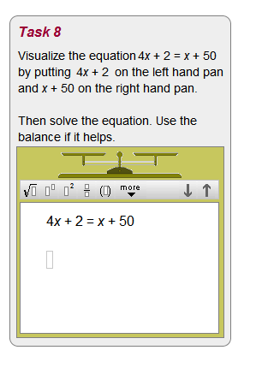
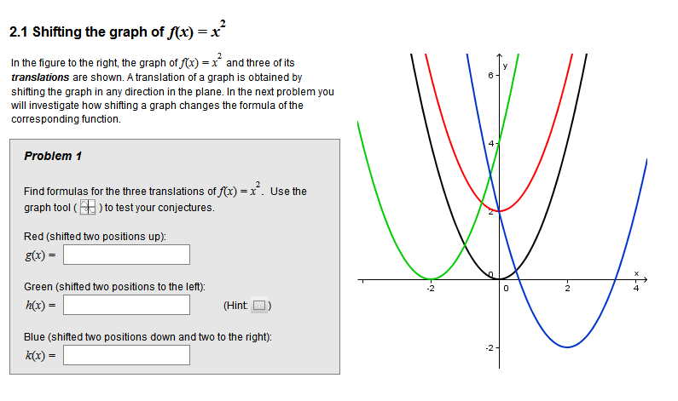
Other cBook ideas

Slide 15
Between countries
Size of group active CoI members. More activity means more production.
Number of ‘new’ CoI members. More new members means less efficiency over the board as the new CoI members still need to get acquainted with the work processes while ‘old’ CoI members are helping the new ones to get there.
Being acquainted with the way a CoI works, the ‘common interest’. More common interest=better and more work. Less common interest=harder to work.
Ability to integrate CoI work in ‘normal job’. Better integration=more efficient. Less integration=less efficient.
Tangible rewards. A clear reward, like money or ‘in kind’ like participation in conferences means more engagement and commitment. Time=money, money=time.
‘Ownership’ of the product that is produced.

Slide 16
Ideas welcomed
http://mc2-project.eu/
http://mathematicsandcreativity.wordpress.com/
After all, you are ‘our’
Community of Practice ;-)

Slide 17
References
Bernstein, B. (1971). Class, codes and control. London, UK: Routledge.
Engeström, Y., Engeström, R., & Kärkkäinen, M. (1995). Polycontextuality and boundary crossing in expert cognition: Learning and problem solving in complex work activities. Learning and Instruction, 5, 319–336.
Fischer, G. (2001). Communities of Interest: Learning through the Interaction of Multiple Knowledge Systems. In the Proceedings of the 24th IRIS Conference S. Bjornestad, R. Moe, A. Morch, A. Opdahl (Eds.) (pp. 1-14). August 2001, Ulvik, Department of Information Science, Bergen, Norway.
Jaworski B. (2006). Theory and practice in mathematics teaching development: critical inquiry as a mode of learning in teaching. Journal of Mathematics Teacher Education, 9(2), 187-211.
Wenger, E. (1998). Communities of Practice: Learning, Meaning, Identity. Cambridge University Press.
Star, S. L. (1989). The structure of ill-structured solutions: Boundary objects and heterogeneous distributed problem solving. In L. Gasser & M. Huhns (Eds.), Distributed artificial intelligence (pp. 37–54). San Mateo, CA: Morgan Kaufmann.
Suchman, L. (1994). Working relations of technology production and use. Computer Supported Cooperative Work, 2, 21–39.
Wenger, E. (1998). Communities of practice, learning, meaning and identity. Cambridge, UK: Cambridge University Press.

