Slide 1
A guide to fish you may find in Southampton rivers and ponds!
Lewis Dolman
Boldrewood Innovation Campus (B178, floor 5), University of Southampton, SO16 7PP.
L.A.Dolman@soton.ac.uk
@lewis_dolman
https://dolmanla.wixsite.com/reseach

Slide 2
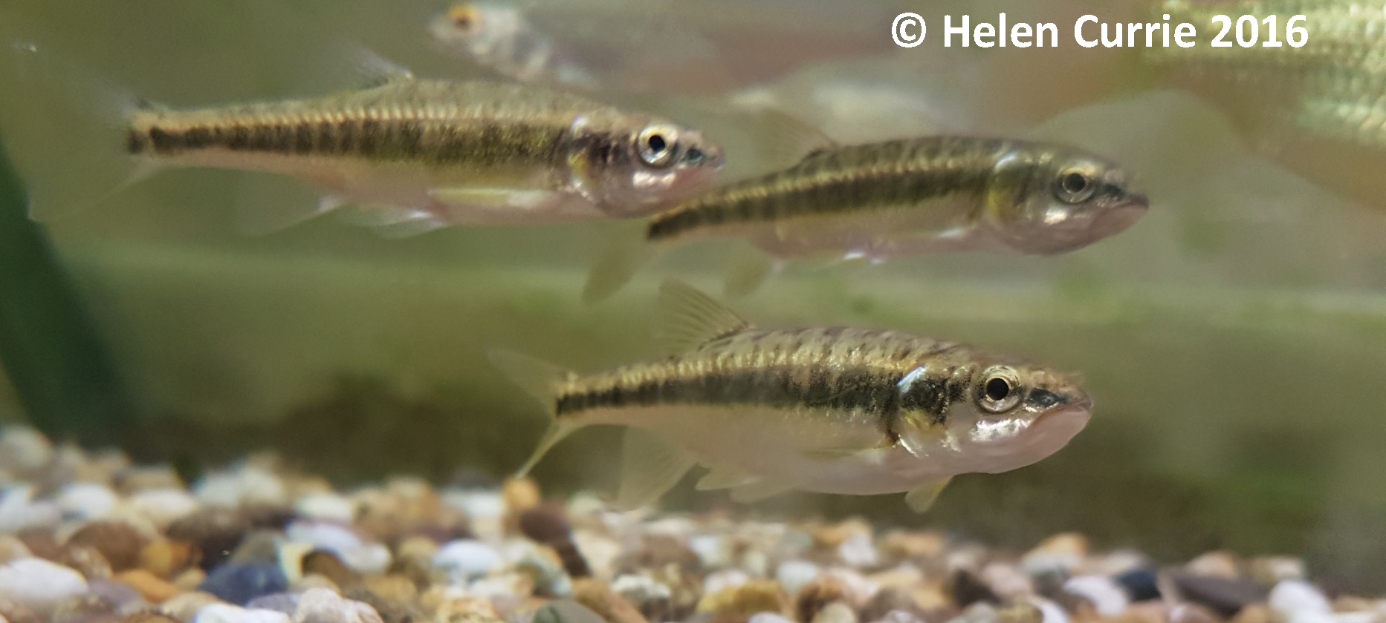
Eurasian minnow
A small grey fish found across Europe and Asia.
Pale, silver/green skin and a black stripe across the centre of their body.
Likes living in big groups in well oxygenated streams, rivers and canals.
Can often be seen searching within gravel for food.

Slide 3
Brown trout
A large, brown fish with black spots across the body and face.
Can often be seen feeding on flies on the surface of the river.
Scares easily, and might be seen swimming quickly!
Found across Europe, but has been introduced to rivers and well-oxygenated ponds across the world for fishing.

Slide 4
Grayling
A medium sized striped silver fish which can be identified by a large colourful fin, body stripes and a downwards facing mouth.
Likes to eats fly larvae on the bottom of rivers and can often be seen in small shoals (groups).
Found in fast flowing rivers across Europe and Russia.

Slide 5
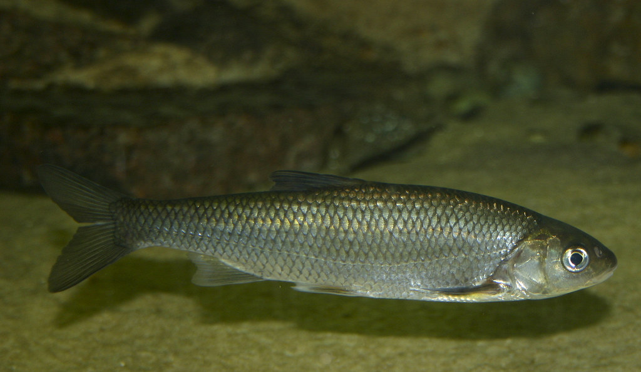
European chub
A large, ‘heavy built’ fish found in rivers and ponds across the UK.
Can be identified by their silver bodies, small scales and triangular dorsal fin (the top fin).
Likes to eat fish and bugs (e.g. worms and slugs!)
These fish prefer to live in deep pools of water.
Photo credit: Brian Gratwick (https://www.flickr.com/photos/19731486@N07/3056891601/in/photolist-5E8nnB-axLw1B)

Slide 6
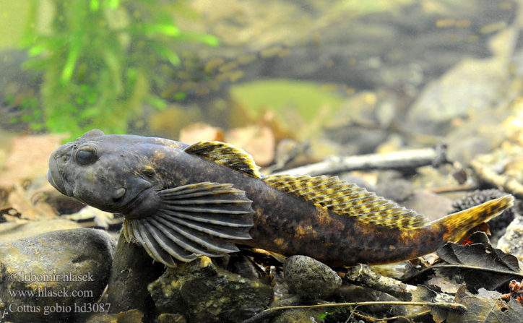
Bullhead
A small brown fish which lives on the bottom of fast flowing rivers.
Use their ‘squashed’ bodies to hide behind pebbles to avoid the flow and large fins to ‘walk’ across the river bottom.
These fish like to eat small bugs hiding within the gravel.
This species is legally protected.

Slide 7
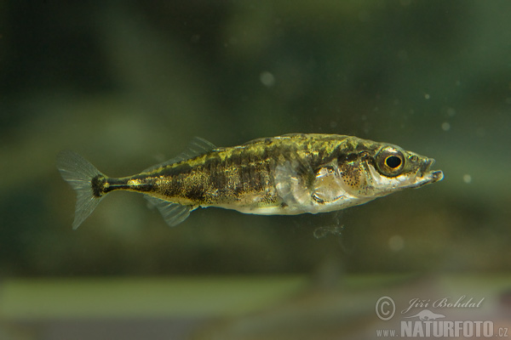
Three-spined Stickleback
A small spiny fish which can be found in rivers and ponds.
Can be either red (males) or silver (females)
Likes to live near weeds or plants out of the river flow.
Swims using their front fins rather than their tails and can appear to be ‘hovering’ in mid-water!

Slide 8
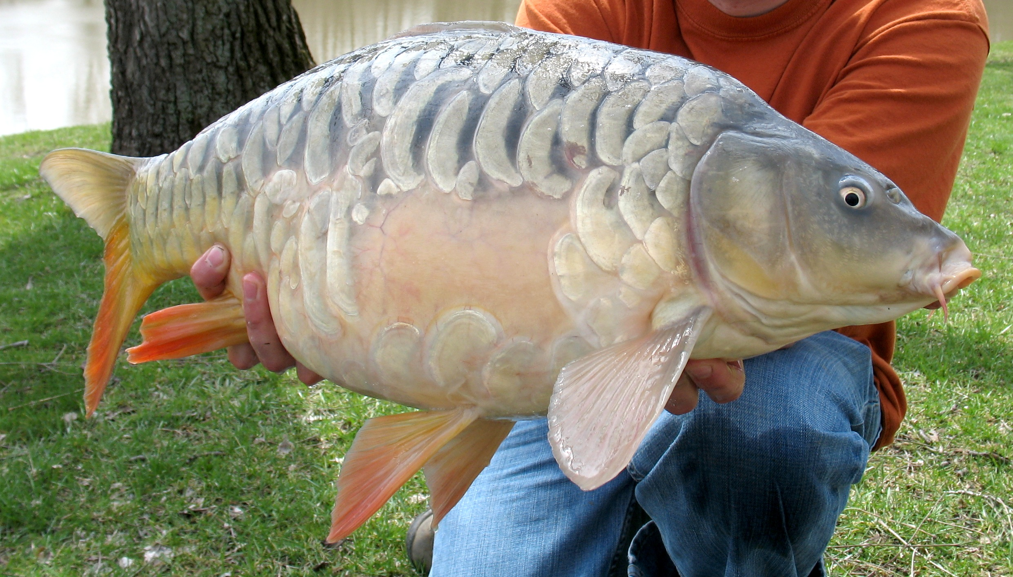
Common or mirror carp
Found in ponds and canals across the world!
Usually brown in colour (but some are orange/red). Some have big plate-like scales (mirror carp) whilst others have small scales (common carp).
Likes to search around in the mud for their food.
Will eat just about anything including fish, bugs, bread, chocolate and strawberries!
Photo credit: Tim Creque (https://commons.wikimedia.org/wiki/File:Rectangle_the_mirror_carp_at_12lb_8oz.jpg)

Slide 9
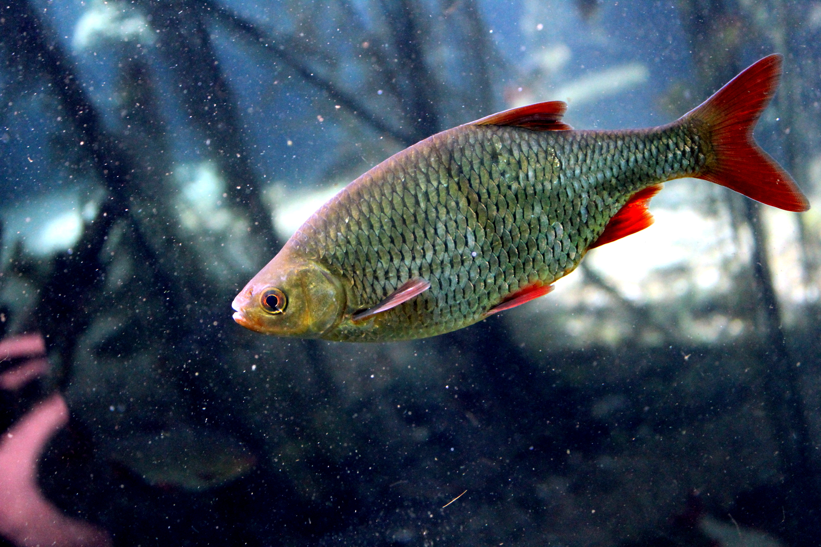
Roach or Rudd
These fish are silver and small with red tails and fins.
Can be seen in groups in ponds and canals.
Main difference between roach and rudd are their mouths, where roach mouths face down and rudd mouths face up.
Photo credit: lidkk (https://commons.wikimedia.org/wiki/File:Common_rudd_wroclaw_zoo.jpg)

Slide 10
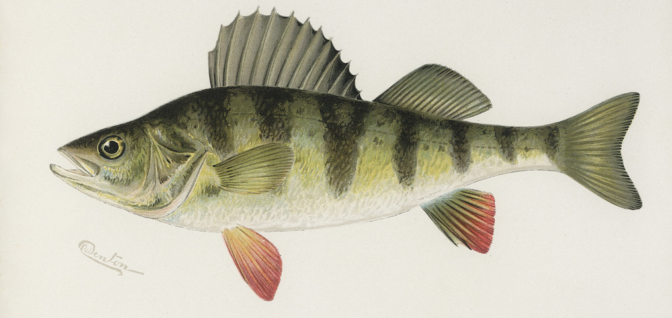
Perch
Perch are a predatory fish which like to eat other small fish and bugs.
Yellow with black stripes and a big spiny dorsal fin (the top one).
Small perch will shoal with other fish species (e.g. Roach), but as they get bigger they tend to be on their own.
Live in ponds and canals.
Photo credit: Rawpixel Ltd (www.flickr.com/photos/vintage_illustration/38977337241)

Slide 11
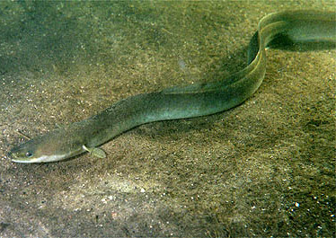
European eel
These long, thin, snake-like fish can reach up to a meter long!
European eel babies ‘swim’ over 5000 km across the sea to live in British rivers and ponds. When they want to breed as adults, they swim all the way back!
These fish are nocturnal and like to come out in the night-time to feed on fish and bugs.
Photo credit: GerardM (https://commons.wikimedia.org/wiki/File:Anguilla_anguilla_(cropped).jpg)

Slide 12
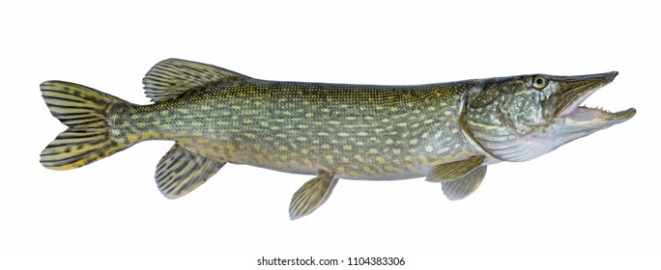
Pike
Pike look a little like crocodiles with their green, white spotted skin (although they won’t hurt us!).
These fish like to hide very still in reeds waiting for small fish to swim by to eat.
Pike can live in a variety of habitats, including ponds, canals and rivers.
Photo credit: Fedbul (https://www.shutterstock.com/g/Fedir+Bulko)

Slide 13
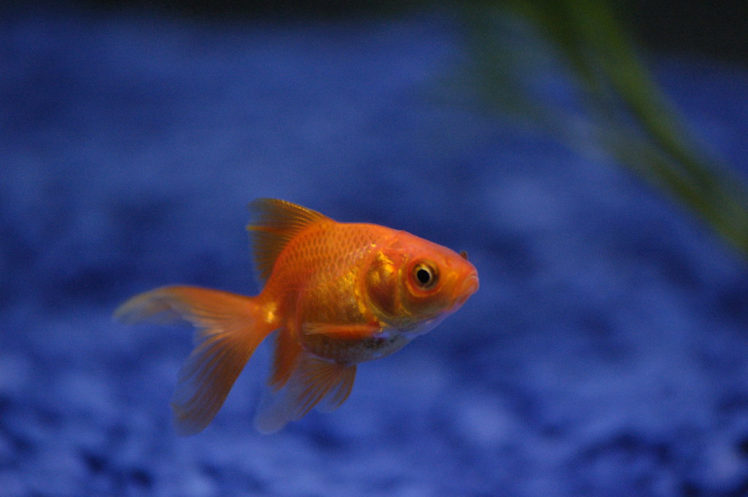
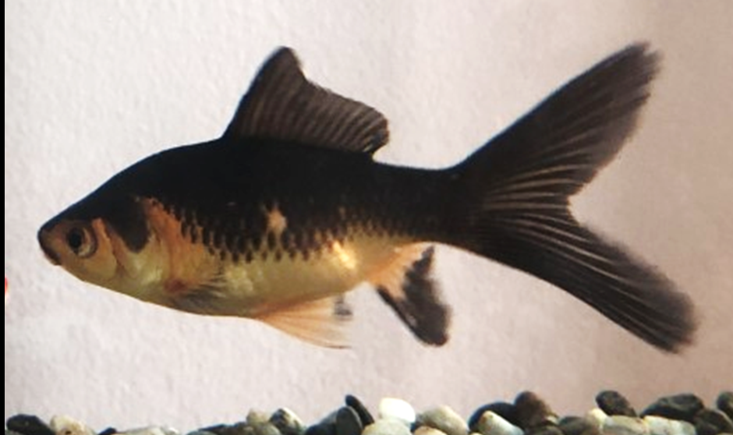
Goldfish and shubunkins
Photo credit: Andrew Percod (https://www.flickr.com/photos/andrewpescod/416263319)
Related to carp, these fish can come in many different colours.
Sometimes called ‘ornamental fishes’.
Live in man-made ponds, but sometimes they are released into the wild.

Slide 14
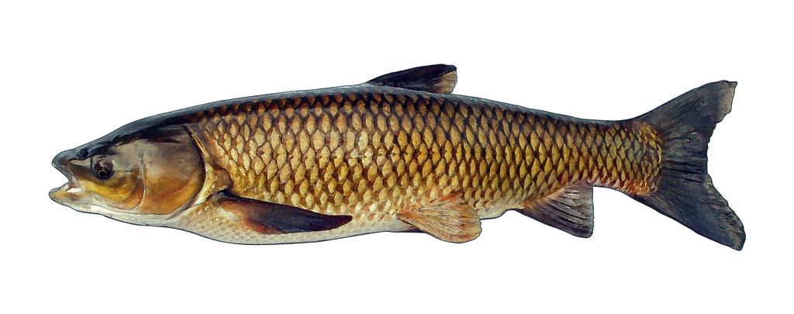
Grass carp
Another type of carp found mainly in fishing ponds.
Long, brown carp with an upward facing mouth.
Not native to Britain, and are sometimes released into the wild!
Photo credit: NYC DEC (https://www.flickr.com/photos/nysdec/29831330532/)

