Slide 1
How do citizens think about politics and how to reform the political system
Gerry Stoker
@ProfStoker
g.stoker@soton.ac.uk

Slide 2
Exploring thinking
Learning from others: Kahneman
The complexity of thinking: automatic through intentional spectrum
Information, evidence and computation through to beliefs and heuristics, to affective influences ( mood, emotions)
Exploring fast and slow thinking as a heuristic

Slide 3
The use of focus groups
14 groups, Nov 2011- march 2012
Why focus groups?
Particular value in exploring fast and slow thinking

Slide 4
Table 1: Properties of fast and slow thinking
Adapted from Stanovich and Toplak (2012)
System 1 ( fast thinking) | System 2 ( slow thinking)
Holistic | Analytic
More influenced by emotions and feelings | Less influenced by emotions and feelings
More Automatic | More Controlled
Relatively undemanding of cognitive capacity | Capacity demanding
Relatively fast | Relatively slow
Parallel | Sequential
Innately present but also acquired by exposure and personal experience | Learnt more by formal tuition and culture input

Slide 5
Fast and slow thinking: exploring the consequences
Is fast thinking about politics good enough?
The dominant mode of citizen-leader exchange?
But with what consequences?

Slide 6
In fast thinking mode
Politics looks like a dark art
Something that is done by others ( to you)
Negativity dominates ( of 209 word associations 132 negative and only 7 positive)

Slide 7
Table 2: Negatives about Contemporary Politics
Word Association Category | Number of Expressions
Deception ( Lies, Spin, Broken Promises etc) | 31
Corruption ( Corrupt , scandal, legal criminality etc) | 24
Feather nesting (expenses overpaid, multiple houses) | 20
Self - serving ( Self-interested, unprincipled, ambitious ) | 12
Politicking ( confrontational, canny, mud-slinging, not listening ) | 15
Privileged social background ( public school, boys club) | 8
Boring ( mind numbing, dull, uninteresting ) | 7
Incomprehensible ( confusing, impossible to understand, a mess ) | 9
Other ( cuts, slow to respond) | 6
TOTAL | 132

Slide 8
A glimmer of light (9-17 comments)
Its impossible to please everyone
The media creates a difficult context for politics
Maybe its up to us to make more effort
Not all politicians are self-serving
On excessive moaning
Life without politics
Grudging respect for politics

Slide 9
Slow thinking mode: a considered critique
They don’t listen ( 23 comments)
Accountability does not work (26 Comments)
Us and Them (33 comments)

Slide 10
Trends in discontentment
Good longitudinal data on public attitudes towards politics and politicians is difficult to come by.
Maybe there was never really a “golden age” of British democratic politics?
We replicated a poll question that was first asked by Gallup in July 1944.
Notes:
“Do you think that British politicians are out merely for themselves, for their party, or to do their best for their country?”

Slide 11
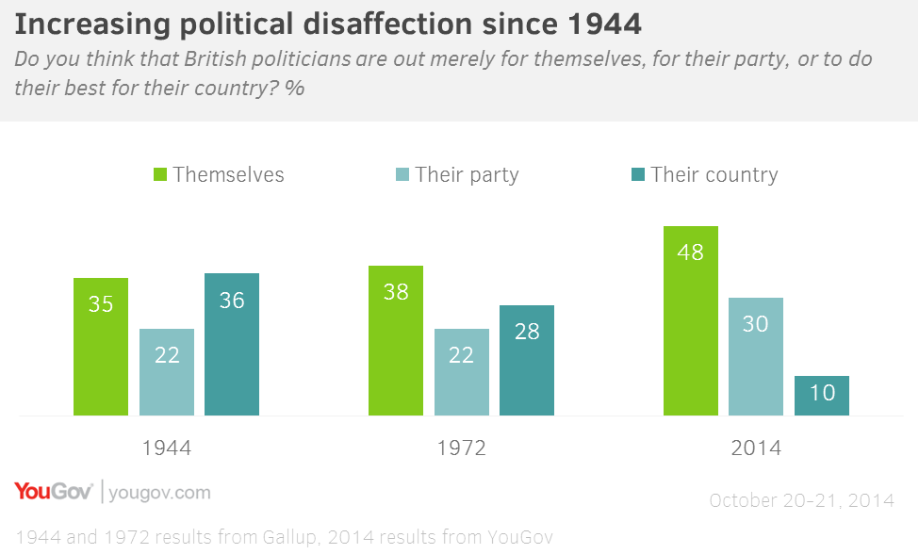
Trends in discontentment
Source: YouGov/University of Southampton, 2,103 GB Adults, Fieldwork: 20th - 21st October 2014

Slide 12
A mixed score card but with clear trends
Interest slightly up; knowledge up
Sense that which party is in power matter down
Duty to vote down and voting in general elections
Sense that system needs major reform up
And all this is having real impact

Slide 13
So what’s different about politics today?
Politics always a difficult art and has disappointment built into its practices but things have got worse
The way that politics is done or practiced has changed
Modern political exchange is increasingly in fast thinking mode
Decline is not the product of short-term policy failure but rather process changes

Slide 14
A greater void between politics and citizens: structural factors
Decline in party membership leading to professionalisation of politics ...elite routes into politics become even narrower
Political exchange with citizens increasingly through marketisation practices...sound bites, dog whistle agenda setting, targeted messages
Fast thinking exchanges ...time efficient but can be costly in terms of making choices

Slide 15
Void reflected in expressions of discontentment
Thinking about the problems facing Britain today, do you agree or disagree with the following statements? | Agree/Disagree (%)
Politicians in government can make a difference to the major social and economic issues facing Britain. | 63 / 13
Politicians have the technical knowledge needed to solve the problems facing Britain today. | 20 / 52
Politicians possess the leadership to tell the public the truth about the tough decisions that need to be made. | 33 / 40
Politicians are too focused on short-term chasing of headlines. | 80 / 3
Politics is dominated by self-seeking politicians protecting the interests of the already rich and powerful in our society. | 72 / 8
Politicians have exaggerated the scale of the economic crisis - by blaming either the previous or the current government. | 47/28
Source: YouGov/University of Southampton, 1,905 GB Adults, Fieldwork: 5th – 6th June 2013

Slide 16
Who “owns” political discontent?
Age as a predictor of negativity:
older voters (typically 60+) tend to be more sceptical that politicians have “technical knowledge”, are “short-termist” and “self-seeking”. Lifecycle effect in disaffection with politics?
despite Generations X and Y participating in formal politics (e.g. elections) less than their elders, they tend to be more positive about politics and politicians …

Slide 17
Who “owns” discontentment?
Social class as a predictor of negativity:
professional/middle class respondents are more sceptical about the capabilities of politicians.
working class respondents are more likely to agree with negative statements about politicians having exaggerated the crisis by blaming the past and current government and for self-serving behaviour that protects interests of the already rich and powerful in society.

Slide 18
Anti-politics reinforces exclusion
Disillusionment leads to non-participation in long-term
Populist surges likely to be followed by slump
Its clear who owns disillusionment to a greater degree
Politics designed around interests of those that remain in: the wealthier ...and those that vote, the elderly not the young

Slide 19

Around this storm of unplanned change elites have added
A storm of intended change:
Devolution
European Union
Reforms to House of Commons Procedures
Reform of the House of Lords
Local government reform
Greater London and city regions
Human Rights Act
Referendums
Political parties
Freedom of information
Electoral and registration changes
Recall MPs
Fixed term parliament
Independence for Bank of England
Remuneration and expenses
And more

Slide 20


Judging that storm of reforms
Effort
Coherence
Political or Legal
Effectiveness
Instability
Greater than the sum of the parts?
Not all the public are not convinced that reforms go to the heart of their concerns

Slide 21
Classification of Political Reform Ideas from Citizens in Focus Groups 2011/12
Reform Idea | Numbers of Mentions (%)
Change processes of politics to make it more accountable and to ensure that what is promised is delivered | 128 (28)
Better education, information exchange and less spin in communication | 68 (15)
Give citizens more of say (especially through referendums) | 73 (16)
Deal with issues that are of concern | 58 (13)
Improve representativeness and accessibility of MPs | 43 (9)
Institutional changes to parliament, constitution reform or changes to electoral system | 41 (9)
Get more experts involved in decision-making | 15 (3)
Create a more positive media environment for politics | 13 (3)
Give local communities more of a say | 7 (-)
Get politicians to be more normal | 4 (-)

Slide 22
Source: Data from Hansard Society (2013) Audit of Political Engagement
Table 5 | Reform preferences for improving politics
Which of the following changes do you think would improve the British political system the most? Please pick up to three.
 | %
Make politics more transparent so that it is easier to follow | 48
Make politicians more accountable for their performance between elections | 39
Better information and education about politics for all citizens | 32
Less ‘spin’ in political communication | 26
Give citizens more of a say (e.g. more referendums, more consultation) | 29
Get experts more involved in decision-making | 17
More positive media coverage of politics | 12
Constitutional changes (e.g. an elected House of Lords, a different voting system) | 8
More people like me as MPs | 6
None of these | 11

Slide 23
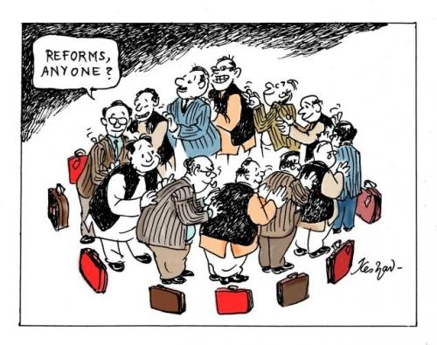
Why failing to connect?
Elites choose reforms that gratify elites.... Bowler and Donovan argument
Nature of unplanned change is difficult to understand and adds to the complex way in which planned reform is received

Slide 24
The way forward
Citizen conventions....taking control out the hands of elites
Combining expertise and lay knowledge
Working back new solutions into the political system
Meeting the challenge from vested interests

