Slide 1
The Impact of Anti-Politics on the UK General Election
Will Jennings & Gerry Stoker
University of Southampton
@ProfStoker @drjennings

Slide 2
Defining Anti-Politics
Shorthand phrase for “popular disillusionment with mainstream politics and politicians”.
Expressed through attitudes, behaviours and collective action.
We need to understand it better because it is having significant impacts on the operation of contemporary democracies, including the UK.

Slide 3
Today…
Anti-politics is widespread and growing.
What are the drivers of anti-politics?
Why does anti-politics matter?
  Electoral impact of political discontentment
  Reinforces exclusion
  Distorts policy processes and outputs

Slide 4
Trends in discontentment
Good longitudinal data on public attitudes towards politics and politicians is difficult to come by.
Maybe there was never really a “golden age” of British democratic politics?
We replicated a poll question that was first asked by Gallup in July 1944.
Notes:
“Do you think that British politicians are out merely for themselves, for their party, or to do their best for their country?”

Slide 5
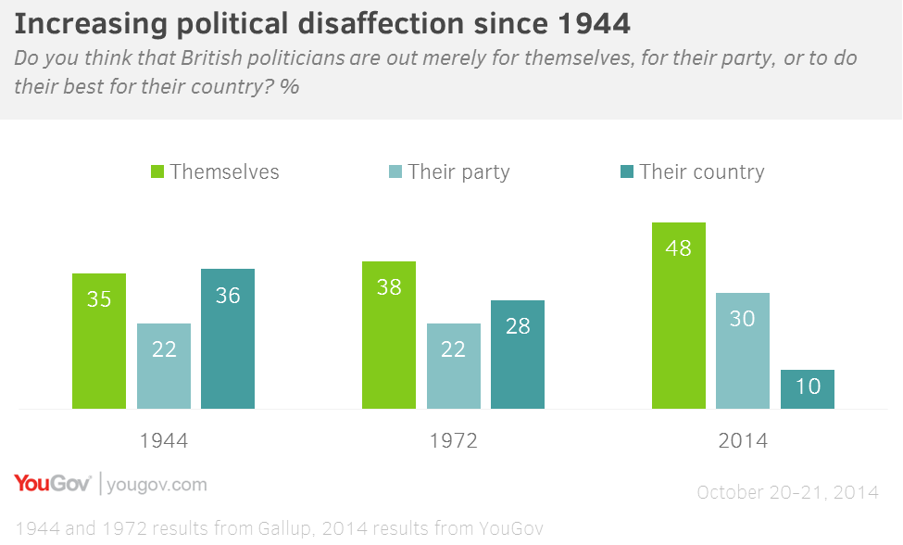
Trends in discontentment
Source: YouGov/University of Southampton, 2,103 GB Adults, Fieldwork: 20th - 21st October 2014

Slide 6
British Election Study - 1974
“Could you tell me the one which best describes how you feel about: Politicians in Britain today?"
    Very happy
    Happy
    Satisfied
    Mixed feelings
    Not satisfied
    Unhappy
    Very unhappy
15%
19%
51%
53%
30%
28%
Feb 1974
Oct 1974

Slide 7
So what’s different about politics today?
Politics has always been a difficult art and has disappointment built into its practices, but things have got worse.
The way that politics is done or practiced has changed: modern political exchange is increasingly in fast thinking mode.
Decline is not the product of short-term policy failure but rather process changes.

Slide 8
A greater void between politics and citizens: structural factors
Decline in party membership leading to professionalisation of politics ...elite routes into politics become even narrower.
Political exchange with citizens increasingly through marketisation ...sound bites, dog whistle agenda-setting, targeted messages.
Fast thinking exchanges: time-efficient but can be costly in terms of making choices.

Slide 9
Void reflected in expressions of discontentment
Thinking about the problems facing Britain today, do you agree or disagree with the following statements? | Agree/Disagree (%)
Politicians in government can make a difference to the major social and economic issues facing Britain. | 63 / 13
Politicians have the technical knowledge needed to solve the problems facing Britain today. | 20 / 52
Politicians possess the leadership to tell the public the truth about the tough decisions that need to be made. | 33 / 40
Politicians are too focused on short-term chasing of headlines. | 80 / 3
Politics is dominated by self-seeking politicians protecting the interests of the already rich and powerful in our society. | 72 / 8
Politicians have exaggerated the scale of the economic crisis - by blaming either the previous or the current government. | 47/28
Source: YouGov/University of Southampton, 1,905 GB Adults, Fieldwork: 5th – 6th June 2013

Slide 10
Who “owns” political discontent?
Age as a predictor of negativity:
  older voters (typically 60+) tend to be more sceptical that politicians have “technical knowledge”, are “short-termist” and “self-seeking”. Lifecycle effect in disaffection with politics?
  despite Generations X and Y participating in formal politics (e.g. elections) less than their elders, they tend to be more positive about politics and politicians …

Slide 11
Who “owns” political discontent?
Social class as a predictor of negativity:
  professional/middle class respondents are more sceptical about the capabilities of politicians.
  working class respondents are more likely to agree with negative statements about politicians having exaggerated the crisis by blaming the past and current government and for self-serving behaviour that protects interests of the already rich and powerful in society.

Slide 12
Why does anti-politics matter?
Back to our YouGov survey from October.
Belief that politicians are “merely out for themselves” explains as much variance in support for UKIP as several demographic factors (via Ford & Goodwin): 55+, male, working class.
Odds of supporting UKIP are three times higher if respondents believe politicians are self-serving.

Slide 13
The electoral impact of distrust
In March 2009, the British Election Study started to ask:
  “Using a scale from 0 to 10 where 0 means 'no trust' and 10 means 'a great deal of trust', how much do you trust politicians.”
Control for a wide range of demographic and attitudinal predictors of UKIP support (as per Ford & Goodwin 2014).
Notes:
Using a scale from 0 to 10 where 0 means 'no trust' and 10 means 'a great deal of trust', how much do you trust politicians.

Slide 14
The electoral impact of distrust
Odds of supporting UKIP are three times higher if a person expressed distrust in politicians.
This effect is the second biggest single effect of any variable; only outstripped by wanting to leave the EU, and greater than concern about immigration.
Notes:
Using a scale from 0 to 10 where 0 means 'no trust' and 10 means 'a great deal of trust', how much do you trust politicians.

Slide 15
Anti-politics reinforces exclusion
Disillusionment leads to non-participation in long-term.
Populist surges likely to be followed by slump.
Its clear who owns disillusionment to a greater degree.
Politics of the few rather than the many.

Slide 16
The electoral impact: false choices
Sound bites hide real choices that are being made.
The extent of the void between politicians and citizens limit the scope for “honest” discussion.

Slide 17
Deficit busting? Talking Austerity
Economists argue whoever is in office will be forced to resort to borrowing again if tax revenues do not rise as forecast.
There will be further cuts (£30 billion are planned), but not on scale Conservatives are projecting, not least as they failed to deliver cuts on a scale promised before.
Why? Take line of least political resistance.

Slide 18
Saving the NHS? But at what cost?
Squeeze has been on local government rather than central government spending.
Protecting the NHS appears to threaten the shredding of other public services.
Ring-fencing NHS and pensions priorities at the expense of economic development.

Slide 19
And solutions?
Lots of false solutions are on offer about changing the practices of citizens.
Changes to the practices of politics are the key.
Hard to deliver because of elite resistance.

