Slide 1
Popular Understandings of Politics in Britain, 1937-2014
Nick Clarke, Gerry Stoker, Will Jennings, Jonathan Moss

Slide 2
Outline
Introduction – context, objectives, R design
Stage 1 – polling data
Stage 2 – material from Mass Observation
Conclusion – dissemination plans
Discussion

Slide 3
1. Introduction

Slide 4


The project
A collaboration between Geography and Environment (G&E) and Politics and International Relations (PAIR) at the University of Southampton
Funded by the ESRC
October 2014 to March 2016
Four investigators:
Nick Clarke
Gerry Stoker
Will Jennings
Jonathan Moss

Slide 5
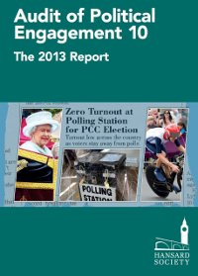
The context
Increasing withdrawal of political support from the institutions of formal politics in Britain and certain other countries since the 1960s
Hansard Society (2013): interest in formal politics, propensity to vote, and approval of the political system have all declined in Britain over the last decade
The causes for such disenchantment and disengagement are not clear – there are many hypotheses (Stoker 2014) but few conclusive results (e.g. Norris 2011)
Missing from existing research on this topic are two things: data for the period prior to 1960; and the voices of citizens

Slide 6
Aims and objectives
Overall aim: to understand better what and how British citizens have thought about formal politics since the late 1930s
Objectives
To establish the range of popular understandings of politics among British citizens
To establish changes in prominence of certain popular understandings over time
To suggest causes for these changes

Slide 7
Research design
Stage 1: analysis of quantitative data available from polling organisations (1937-2014)
Stage 2: analysis of qualitative data available from the Mass Observation Archive (1945-2014)
Stage 3: integration of findings from historical research with relevant contemporary research (e.g. Hansard Society 2012)

Slide 8
2. Stage 1 – polling data

Slide 9
Stage 1
Collection of historical aggregate poll data and survey questions, e.g. Gallup International Public Opinion Polls, Great Britain: 1937-1975, on public attitudes towards politics, parties and politicians. What sorts of questions are asked at different points in time (e.g. approval, trust, conduct)?
Collection of individual-level data from the BES (1964-2015), BSAS (1983-2014) and other datasets deposited in the UK Data Archive.

Slide 10
Stage 1
But potential for tracking longitudinal trends in public attitudes towards politics with quantitative data limited by historical repertoires of question wordings (and contemporary concerns).
Example of a creative solution: replication of Gallup question first asked in 1944 (and in 1972).
“Do you think that British politicians are out merely for themselves, for their party, or to do their best for their country?”

Slide 11
Stage 1
Source: YouGov, 2,103 GB Adults, Fieldwork: 20th - 21st October 2014

Slide 12
Stage 1
Conservative voters are more positive: 34% think politicians out for themselves, 21% that they are out to do what is best for their country.
UKIP voters are most negative: 74% think that politicians are out for themselves, just 3% to do what is best for their country.
Implication: historical comparisons may also provide insights into current trends/patterns in popular attitudes towards politics.

Slide 13
3. Stage 2 – material from Mass Observation

Slide 14

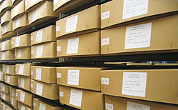
Stage 2 – data collection
Mass Observation
Est. 1937
1937-60: mass observers
1937-65: panellists (day surveys, directive responses, diaries)
1970: est. of Mass Observation Archive
1981-present: Mass Observation Project
Eight relevant directives:
Pre-1960s: Feb/Mar 1945, May/Jun 1945, Nov 1945, Jul 1950, Nov 1950
Post-1960s: Aut/Win 1996 combined with Spr 1997, Spr 2010, Spr 2014
Responses per directive: 98-369
Panel not formally representative but: it is more representative than is often assumed; we can sample within it; this is not essential

Slide 15
Stage 2 – data analysis
Cognitive science and anthropology: people make sense of the world using shared cultural models or folk theories
Post-structuralism: common sense gets made and unmade through two discursive processes: the circulation by experts of cultural resources; interaction whereby people dispose themselves towards cultural resources in particular ways
Research questions:
What is the range of popular understandings of politics among British citizens?
On what shared cultural resources do such understandings draw?
From what communicative interaction do such understandings emerge?
How has all this changed over time?

Slide 16
Stage 2 – Example questions
Feb/Mar 1945: What would you say is your normal conversational attitude when talk gets round to politicians?
Nov 1950: Give an account of the development of your feelings about politics and of your political outlook and sympathies.
Aut/Win 1996: Keep a diary in the run-up to the General Election. It should include your reactions to the political situation, the issues which are being debated, the media, the performance of politicians, your opinions of the campaigns, and your own involvement.
Spr 2010: The General Election 2010. What do you think? Are you excited by the possibilities of change or are you bored already? Are you actively involved in electioneering or will you let the whole thing pass you by? What does it mean to you?

Slide 17
Stage 2 – Example responses
Feb/Mar 1945: What would you say is your normal conversational attitude when talk gets round to politicians?
Female teacher, 48, Watford: ‘[…] Labour sympathisers seldom mention Tory politicians except when one of them says something particularly silly or startling […]. Conversations with Tories usually finish with the remark “politicians are only out for what they can get” or “politics is a dirty business” and they usually mean that socialists only want to make a living out of politics’.
Female teacher, 45, Burwash Weald: ‘[…] The weakness of politicians is that they follow the crowd (or votes) where they should take a risk, strike a higher note and lead. Party loyalty at the expense of principle is often overdone. Many dislike party politics and almost all think they are wrong. Hence politicians are thought to be dishonest and self-seeking because they disagree’.

Slide 18
4. Conclusion

Slide 19
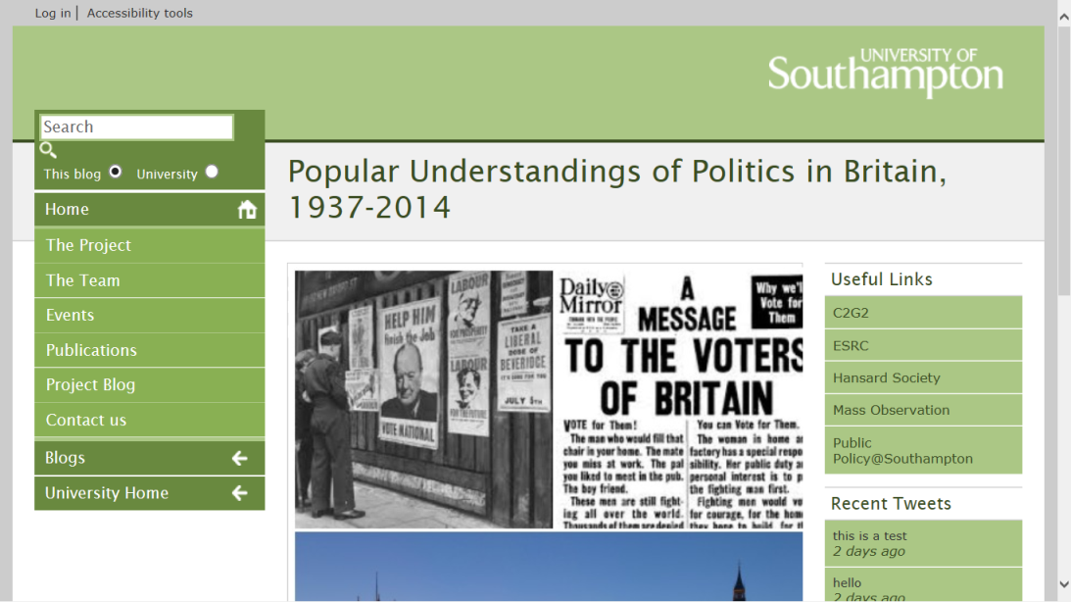
Plans for dissemination
Website: www.antipolitics.soton.ac.uk
Conferences: PSA 2015; ECPR 2015; RGS-IBG 2015
Journal papers and book
Executive summary of findings
Impact events (early 2016): briefing for journalists (with the Hansard Society); workshop in London; TEDx style conference in Southampton

Slide 20
5. Discussion

